Slide 1
GOOD PRACTICES
PROJECT OF ….
…. MUNICIPALITY
MUNICIPALITY LOGO
(.png format)

Slide 2
CONTENTS
03
04
IMPLEMENTATION PLAN
OF THE PROJECT
THE GOAL OF THE PROJECT
03
01
02
SCOPE OF THE PROJECT
GAINS OF THE PROJECT
…..Project
…...Municipality

Slide 3
01 | THE GOAL OF THE PROJECT
P
H
O
T
O
G
R
A
P
H
Withing th scope of the ......Project,it is aimed to ...(to be recycle and brought into the economy).
The activities carried out in the municipality within the scope of the Zero Waste project should be summarised in 2-3 lines as a summary. Font character should be Arial, font size should be 36 pt.
It is aimed to estaglish a citizen incentive system that will set an example for municipalities, and in doing so, ....logoc has been adoped.
..will the call ..... Project has been prepared.
The project should be detailed.The typeface should be
Arial and the font size should be 28 pt.
…..Project
…...Municipality
REPUBLIC OF TÜRKİYE MINISTRY OF ENVIRONMENT,
URBANIZATION AND CLIMATE CHANGE

Slide 4
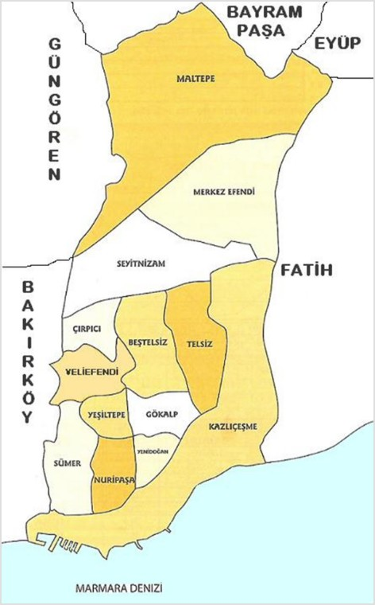
02 | SCOPE OF THE PROJECT
PHOTOGRAPH
Municipality
………..
Population
……….
Neighborhood
ADD DISTRICT MAP
The project should be detailed.The typeface should be
Arial and the font size should be 28 pt.
…..Project
……Municipality
REPUBLIC OF TÜRKİYE MINISTRY OF ENVIRONMENT,
URBANIZATION AND CLIMATE CHANGE

Slide 5
03 | IMPLEMENTATION PLAN OF THE PROJECT
….. The project covers ..... wastes..
In the project, .... mobile vehicles specially equipped to serve... neighbouthoods per day and fixed collection points were established in... different neigbourhoods.
… ... In a week, ....at different points ...the entjre district is served.
01
02
03
Text about Step 1
(Text)
(Text)
(Text)
Text about Step 2
(Text)
(Text)
(Text)
Text about Step 3
(Text)
(Text)
(Text)
The project should be detailed.The typeface should be
Arial and the font size should be 28 pt.
25 Ocak 2023
…..Project
……Municipality
REPUBLIC OF TÜRKİYE MINISTRY OF ENVIRONMENT,
URBANIZATION AND CLIMATE CHANGE

Slide 6
03 | IMPLEMENTATION PLAN OF THE PROJECT
03 | IMPLEMENTATION PLAN OF THE PROJECT
Information graphics about the project
Step 3
(Texts)
(Texts)
Step 3
(Texts)
((Texts))
Step 3
(Texts)
(Texts)
The steps regardin the implementation plan of the Project should be detailed with information graphics.
…..Project
……Municipality

Slide 7
03 | IMPLEMENTATION PLAN OF THE PROJECT
03 | PROJENİN
Step 2
Step 3
Step 4
Step 5
Step 1
Information graphics about the project
The steps regarding the project's implementation plan should be detailed with information graphics.
…..Project
……Municipality
REPUBLIC OF TÜRKİYE MINISTRY OF ENVIRONMENT,
URBANIZATION AND CLIMATE CHANGE

Slide 8
04 | GAINS OF THE PROJECT
The amount of waste sent for recycling has been increased.
The amount of waste going to disposal has been reduced.
Waste was recycled into the economy.
The development of the country was supported by ensuring that the collected waste was recycled into production.
Economic support was provided to citizens.
Zero waste living methods have been implemented in households.
Partnerships have been developed for social responsibility.
A sense of "Conscious Consumer" was achieved.
Within the framework of circular economy, the habit of separation at the source has been introduced to the public.
Achievements related to the project should be detailed with texts.
…..Project
……Municipality

Slide 9
04 | GAINS OF THE PROJECT
PHOTOGRAPH
In the Project in …. (week, months or year)
… members apply joining about ….citizens were served. … to the person service was provided. / training was given. / awareness was created | ……TL savings were achieved. / … greenhouse gas emissions were prevented. / … water and energy savings were achieved. | About … tons recoverable waste collected / waste reduction achieved.
…..Project
……Municipality

Slide 10
04 | GAINS OF THE PROJECT
AMOUNT OF COLLECTED WASTE
WASTE VEGETABLE OIL
%...
PAPER-PLASTIC GLASS-METAL
%....
WASTE BATTERY
%....
ELECTRONIC
WASTE
%...
Project-related achievements should be detailed with numbers.
…..Project
……Municipality

Slide 11
04 | GAINS OF THE PROJECT
The project…. The collection amount in the year is approx. %... has increased.
TOTAL
2022 2023
2021
1.500 TON
8.000
4.000 TON
13.500 TON
Project-related achievements should be detailed with numbers.
…..Project
……Municipality

Slide 12
REPUBLIC OF TÜRKİYE MINISTRY OF ENVIRONMENT, URBANIZATION AND CLIMATE CHANGE

