Slide 1
Technical Assistance for Development of End-Of-Waste Concept in Türkiye
TR2018 ESOP MI A2.05 / SER / 31
Opening Event Project Introductory Presentation Elina Velinova STOYANOVA-LAZAROVA
Team Leader
June 15, 2023
Ankara

Slide 2
Technical Assistance for Development of End-Of-Waste Concept in Türkiye
Overall Objective
To reduce depletion of natural resources used in production and amount of waste generated by promoting the usage of secondary raw materials and enhancing market for high quality recyclables, which ultimately contribute to the sustainable development of the country
Project Purpose
To develop technical and institutional capacity for identification and effective implementation of End-of-Waste criteria for specific waste streams in Türkiye in line with the Waste Framework Directive (2008/98/EC) and the Directive (2018/851).
Result 1
Result 2
Result 3
Current situation is analysed for potential of ten waste streams as secondary raw materials in Turkish context within the perspective of End-of-Waste concept
A comprehensive national strategy and technical capacity is developed for implementation of End-of-Waste criteria for different waste streams.
Capacity of competent authorities and relevant sectors on waste as a resource concept and on implementation of End-of-Waste criteria is improved in Türkiye.

Slide 3
Technical Assistance for Development of End-Of-Waste Concept in Türkiye
Component 1
Analysis of candidate waste streams for End-of-Waste criteria in Türkiye

Slide 4
Technical Assistance for Development of End-Of-Waste Concept in Türkiye
Activity 1.1 Analysis of Waste Streams in Türkiye
Metal (Iron, steel and aluminium) Scrap
Waste Plastic
Copper Scrap
Waste Textiles
Glass Cullet
Construction Aggregates
Waste Paper
Waste Tyres
Biodegradable Waste
Refuse Derived Fuel (RDF)
Current situation in Türkiye will be assessed including collection, current processes applied (recycling, recovery…etc.), uses of recycled or recovered materials, available standards or specifications, market for trade (internal and abroad), demanding sectors

Slide 5
Technical Assistance for Development of End-Of-Waste Concept in Türkiye
Activity 1.1 Analysis of Waste Streams in Türkiye
Sub-Activity 1.1.1
Sub-Activity 1.1.2
Sub-Activity 1.1.3
Sub-Activity 1.1.4
outputs
outputs
outputs
outputs
Guideline on clarification and harmonisation of waste related definitions
Questionnaire forms on data collection
Technical site visits
Report on analysis of waste streams in Türkiye
100 filled questionnaires
Company Visits Reports
Presentation of main findings for each waste stream
Notes:
Political commitment is crucial. Uncertainties for adoption of new Laws (i.e. draft Framework Law on waste, Draft Law on Ecological control, Draft Law on chemical safety, etc.) and the possible changes in the future could potentially affect the activities related to the drafting of new legislation
Mutual trust and respect is a crucial condition for the success of project activities

Slide 6
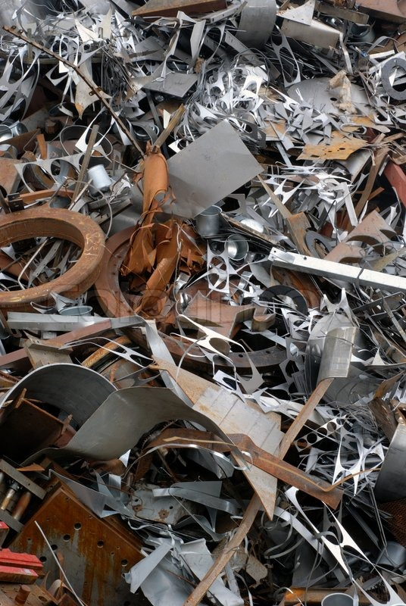
Technical Assistance for Development of End-Of-Waste Concept in Türkiye
Sub-Activity 1.1.1
Guidance report on clarification and harmonisation of waste related definitions and concepts
Analysis of both the EU and Turkish legislation - review amended EU Waste Framework Directive, definitions used for statistical purposes by Eurostat and the Organisation for Economic Cooperation and Development (OECD) and Turkish waste related legislation including recent By-Law on Zero Waste, By-Law on Waste Management
Harmonisation of definitions and concepts of waste, municipal waste, hazardous/non-hazardous waste, pre-treatment, prevention, re-use, preparation for re-use, recycling, recovery, disposal, production residue, secondary raw material, alternative fuel, alternative raw material, industrial symbiosis, by-product, end-of waste.

Slide 7
Technical Assistance for Development of End-Of-Waste Concept in Türkiye
Sub-Activity 1.1.2
Review of the existing databases such as Waste Declaration System (TABS), Mobile Waste Tracking System (MoTAT), Mass Balance System (KDS), Packaging Information System (ABS), and inventories from other studies, TurkStat database, Industry Databases, data from national and international reports on the field, other relevant studies
Develop stakeholder matrix
Data collection on waste streams through questionnaires, adapted for each industry and for each type of materials
Data and information to be compiled for each of 10 waste streams

Slide 8
Technical Assistance for Development of End-Of-Waste Concept in Türkiye
Sub-Activity 1.1.3
Technical site visits
For each waste stream 3 industries will be selected, in total 30 company visits will be conducted
Aim of the company visits is to support data collection and track the flow of waste streams on site
30 Company Visits Reports
One comprehensive report based on 30 company visits

Slide 9
Technical Assistance for Development of End-Of-Waste Concept in Türkiye
Sub-Activity 1.1.4
Comprehensive report on the analysis of selected 10 waste streams in Türkiye, based on Results of the activity 1.1.2 and 1.1.3
Environmental and human health impacts, economic and market impacts and social impacts associated with each waste stream will be assessed briefly for the current situation
Prepare a comparison base for impact assessments studies to be conducted in the second component of the project and other future impact assessment studies necessary to introduce end-of-waste criteria for a specific waste stream

Slide 10
Technical Assistance for Development of End-Of-Waste Concept in Türkiye
Activity 1.2 Benchmark analysis on related End-of-Waste legislation and practices between Türkiye and the EU
2 section report on benchmark analysis
First section
Repository document for all adopted national and EU level end-of-waste, alternative raw material and by-product criteria in the EU and compare 2 selected EU countries with current situation in Türkiye in terms of legislation including strategy papers, administrative procedures, plans, laws, acts and regulations.
Second section
Member States' practices regarding implementation and verification of provisions on end-of-waste criteria and by-product conditions

Slide 11
Technical Assistance for Development of End-Of-Waste Concept in Türkiye
Component 2
Development of national strategy and technical capacity about implementation of End-of-Waste criteria in Türkiye
Task
2.1

Slide 12
Technical Assistance for Development of End-Of-Waste Concept in Türkiye
Activity 2.1 Preparation of draft Technical Regulations
Sub-Activity 2.1.1
Sub-Activity 2.1.2
Sub-Activity 2.1.3
outputs
outputs
outputs
Nine workshops on Impact assessment studies
Three separate workshops for each of the waste streams (iron, steel and aluminium scrap, glass cullet and copper scrap)
Draft Technical Regulations
Impact assessment studies on End-of-Waste Criteria for iron, steel and aluminium scrap, glass cullet and copper scrap according to Turkish context
3 Draft Technical Regulations on establishing criteria determining when certain types of metal (iron, steel and aluminium) scrap, glass cullet and copper scrap cease to be waste
environmental and human health impact assessment
economic and market impact assessment
legislative and social impact assessments
Draft Regulation on general principles of end-of waste criteria
Notes:
Political commitment is crucial. Uncertainties for adoption of new Laws (i.e. draft Framework Law on waste, Draft Law on Ecological control, Draft Law on chemical safety, etc.) and the possible changes in the future could potentially affect the activities related to the drafting of new legislation
Mutual trust and respect is a crucial condition for the success of project activities

Slide 13
Technical Assistance for Development of End-Of-Waste Concept in Türkiye
Activity 2.1 Preparation of draft Technical Regulations
End-of-waste criteria are not compulsory, choice / benefit whether to seek end-of-waste certification or continue to manage the material as waste
Waste Framework Directive 2008/98/EC
Council Regulation (EU) No 333/2011 on determining the criteria for end of waste status regarding iron, steel and aluminium scrap
Council Regulation (EU) No. 1179/2012 on determining the criteria for end of waste status in relation to glass gullet
Council Regulation (EU) No. 715/2013 on determining criteria for end of waste status regarding copper scrap

Slide 14
Activity 2.1 Preparation of draft Technical Regulations
Sub-Activity 2.1.1
Report of Impact assessment studies on End-of-Waste Criteria for iron, steel and aluminium scrap, glass cullet and copper scrap according to Turkish context as described in the section 1.5 of the JRC’s End-of-Waste Criteria report
comparison of impacts with “end-of-waste criteria scenario” with “no action or business as usual scenario”
Economic and market impact assessment
Legislative impact assessment
Social impact assessment
Previous studies on impact assessment studies from the EU member states or JRC will be used as guidance
The results of the workshops described in Activity 2.1.2 will be integrated into this report

Slide 15
Technical Assistance for Development of End-Of-Waste Concept in Türkiye
Activity 2.1 Preparation of draft Technical Regulations
Sub-Activity 2.1.2
Nine workshops on Impact Assessment Studies
For each of the waste streams (iron, steel and aluminium scrap, glass cullet and copper scrap, three separate workshops will be organised
First workshop about environmental and human health impact assessment
Second workshop about economic and market impact assessment
Third workshop will cover legislative and social impact assessments together
Activity reports of workshops

Slide 16
Technical Assistance for Development of End-Of-Waste Concept in Türkiye
Activity 2.1 Preparation of draft Technical Regulations
Sub-Activity 2.1.3
Waste Framework Directive 2008/98/EC
Draft Regulation on general principles of end-of waste criteria
Development of 3 Draft Technical Regulations
Council Regulation (EU) No 333/2011 on determining the criteria for end of waste status regarding iron, steel and aluminium scrap
Council Regulation (EU) No. 1179/2012 on determining the criteria for end of waste status in relation to glass gullet
Council Regulation (EU) No. 715/2013 on determining criteria for end of waste status regarding copper scrap

Slide 17
Technical Assistance for Development of End-Of-Waste Concept in Türkiye
Activity 2.1 Preparation of draft Technical Regulations
Sub-Activity 2.1.3
Waste input material for the recovery operation is permissible.
The treatment processes and techniques are allowed.
The quality criteria applied to the end-of-waste materials are in line with the applicable product standards, including limit values for pollutants where necessary
Requirements are set for management systems to demonstrate compliance with the end-of-waste criteria including for quality control and self-monitoring, and accreditation.
Requirement for a statement of conformity.

Slide 18
Activity 2.2 Workshops to evaluate regulations and guidelines prepared within the project
Five Evaluation Workshops
metal (iron, steel and aluminium) scrap
glass cullet
copper scrap
textile
5th workshop
Discuss both Draft Regulation on determining the criteria for end of waste status regarding iron, steel and aluminium scrap and guidelines
Discuss both Draft Regulation on determining the criteria for end of waste status in relation to glass gullet and guideline
Discuss both Draft Regulation criteria for end of waste status regarding copper scrap and guideline
Discuss both Draft Regulation criteria for end of waste status regarding textile and guideline
(online workshop)
Discuss regulations and guideline for case by case determination of end-of-waste status independent from the waste stream

Slide 19
Activity 2.3 Revision of National Regulations and Preparation of Roadmap on implementation of end-of-waste criteria for different waste streams
Review the amendments in the EU Waste Framework Directive 2008/98/EC and other related EU legislation
Report on recommendations on possible changes and amendments after adopting the end-of-waste criteria to the relevant Turkish waste legislation
Report about recommendations on revision of National Regulations on Waste
Roadmap/ National Strategy document of Türkiye for introduction and implementation of end-of-waste criteria for different waste streams in Türkiye

Slide 20
1
Activity 2.4 Guidelines on Implementation of End-of-waste in Türkiye
1
General Guidance for end-of-waste
2
Guidance for iron, steel and aluminium scrap
3
Guidance for copper scrap
4
Guidance for glass cullet
5
Guidance for biodegradable waste (compost and digestate)
6
5
Guidance for construction aggregates
7
Guidance for textile
Notes:
Political commitment is crucial. Uncertainties for adoption of new Laws (i.e. draft Framework Law on waste, Draft Law on Ecological control, Draft Law on chemical safety, etc.) and the possible changes in the future could potentially affect the activities related to the drafting of new legislation
Mutual trust and respect is a crucial condition for the success of project activities

Slide 21
Technical Assistance for Development of End-Of-Waste Concept in Türkiye
The Make it Work initiative (MiW) is a joint effort with the European Union Network for the Implementation and Enforcement of Environmental Law (IMPEL)
Tool developed by IMPEL is ‘Making the Circular Economy Work – Guidance for regulators’
Eurostat Guidance on municipal waste data collection, JRC Guidance for separate collection of municipal waste, EU reference model harmonising separate waste collection systems form 2020
EU Science Hub (RMIS) policies and definitions (example secondary raw material)

Slide 22
Technical Assistance for Development of End-Of-Waste Concept in Türkiye
https://susproc.jrc.ec.europa.eu/susproc_home
Less waste, more value.
List of publications of JRC research on waste
Webpage on Best Environmental Management Practice
Webpage with additional background information on Best Environmental Management Practice
Webpage on Green Best Practice Community

Slide 23
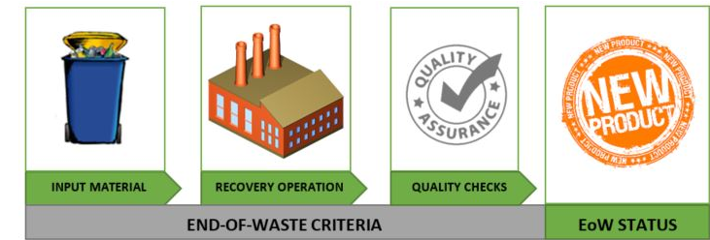
Technical Assistance for Development of End-Of-Waste Concept in Türkiye
Creator: Attard Bason Marie Claire at ERA https://era.org.mt/topic/end-of-waste-criteria/

Slide 24
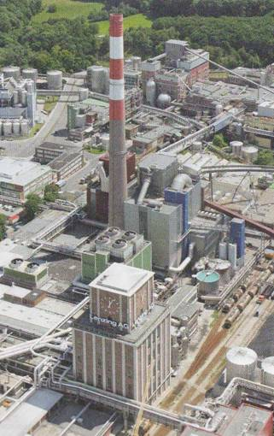
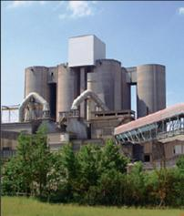
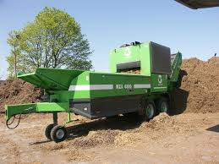
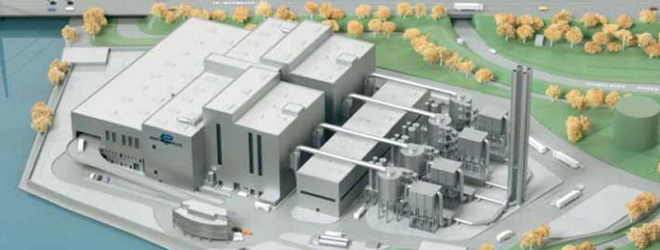
Technical Assistance for Development of End-Of-Waste Concept in Türkiye
Sorting of mixed municipal waste
Production and market for RDF?
Cement Plant
Composting
Paper factory Lenzing
RDF steam plant
RDF Power Plant Peute 100 MWel – 700,000 t RDF/ a

Slide 25
Technical Assistance for Development of End-Of-Waste Concept in Türkiye
Quality management system (ISO 9000 series) / environmental management system (ISO 14000 series), or EMAS includes a set of documented procedures regarding:
1) control of the acceptance of waste used as an input fraction;
2) monitoring of processes and technologies (recovery operations);
3) monitoring the quality of glass gullet / scrap metal obtained as a result recovery operations (including sampling and analysis);
4) customer reviews regarding compliance of broken glass/ scrap metal with quality standards;
5) keeping records of monitoring results, which is carried out in accordance with items (1) to (3);
6) effectiveness of radiation monitoring (for scrap metal);
7) analysis and measures to improve the management system;
8) staff training. The management system should also define the specific monitoring requirements outlined for each criterion.
2.1
4
Notes:
Political commitment is crucial. Uncertainties for adoption of new Laws (i.e. draft Framework Law on waste, Draft Law on Ecological control, Draft Law on chemical safety, etc.) and the possible changes in the future could potentially affect the activities related to the drafting of new legislation
Mutual trust and respect is a crucial condition for the success of project activities

Slide 26
Technical Assistance for Development of End-Of-Waste Concept in Türkiye
Component 3
Capacity development of competent authorities and relevant target groups in terms of End-of-Waste implementation in Türkiye
Task
2.1

Slide 27
Activity 3.1 Training Programs
First Training 1
For the competent authorities in Türkiye to get familiar with the end-of-waste framework including legislation and practices in the EU in the context of assessment, inspection and monitoring of the end-of-waste
For the representatives of the industrial sectors from stakeholders and target groups to introduce end-of-waste framework and details of the guidelines prepared in the activity 2.3 -metal (iron, steel, aluminium) and copper sector
Second training 2
BRIF
Third Training 3
For the representatives of the industrial sectors from stakeholders and target groups for glass sector and any other sector interested in end-of-waste in Türkiye
Notes:
Political commitment is crucial. Uncertainties for adoption of new Laws (i.e. draft Framework Law on waste, Draft Law on Ecological control, Draft Law on chemical safety, etc.) and the possible changes in the future could potentially affect the activities related to the drafting of new legislation
Mutual trust and respect is a crucial condition for the success of project activities

Slide 28
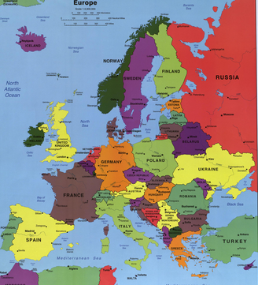
Activity 3.2 Performing Study Visit
1 study visit which covers 2 EU countries
EU Country 1
EU Country 2

Slide 29
Technical Assistance for Development of End-Of-Waste Concept in Türkiye
Component 4
Publicity Activities
Task
2.1

Slide 30
Activities
Activity 4.1
Communication Strategy and Action Plan
Opening Meeting
Activity 4.2
Activity 4.3
Project website and social media accounts
Preparation of project short video and other visibility materials
Activity 4.4
Activity 4.5
Closing meeting

Slide 31
Activity 4.3: Project website and social media accounts
Project website and social media accounts
All social media account names taken on June 8th. The website is under construction.
www.linkedin.com/company/atiksonu-endofwaste
@atiksonu_eow
@atiksonu_endofwaste
www.facebook.com/atiksonu.endofwaste

Slide 32
Technical Assistance for Development of End-Of-Waste Concept in Türkiye
Teşekkürler!

