Slide 1
Technical Assistance for Development of End-Of-Waste Concept in Türkiye
TR2018 ESOP MI A2.05 / SER / 31
Opening Meeting Adam Iwaszko Project Director
June 15, 2023
Ankara

Slide 2
Project objective To reduce depletion of natural resources used in production and amount of waste generated by promoting the usage of secondary raw materials and enhancing market for high quality recyclables, which ultimately contribute to the sustainable development of the country.

Slide 3
Our guiding principles of the project implementation
Principle 1: Fostering ownership and empowerment of main stakeholders and target groups through the needs-based approach
We will maintain continuous communication with the main MoEUCC representatives and other stakeholders and perform the thorough needs assessments to deliver best suited tools and capacity building tasks.
Principle 2: Active involvement, participatory approach and close collaboration
We will apply across the project and its activities a multi-stakeholder engagement approach that would support in building social consensus around EoW system implementation and increase awareness and motivation for the required changes.

Slide 4
Our guiding principles of the project implementation
Principle 3: Prioritising capacity development through a multitude of tools and techniques
We will create a clear, results-oriented, and resilient long-term capacity development framework to be applied in the whole course of the Project’s lifetime.
Principle 4: Taking stock of past and ongoing initiatives and having a thorough understanding of the local context
We will build upon understanding and appreciation of previous and ongoing implementations to avoid any overlaps and create synergies wherever possible.
Principle 5: Capitalising on national and EU expertise from competent universities and research institutes
We will engage and benefit from cooperation with competent national organisations and international expertise.

Slide 5
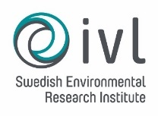
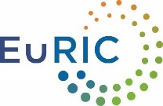
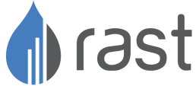
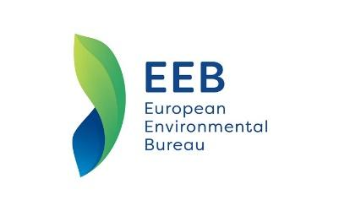
Our Consortium
Swedish Environmental Research Institute (IVL) which is Sweden’s leading environmental research institute.
EuRIC (European Recycling Industries' Confederation) represents the recycling industry at a European level.
RAST Engineering, a multi-disciplinary consultancy and engineering company.
NIRAS, a consultancy and engineering company, that works with worldwide donor agencies and has more than 2 400 employees.
Support from - European Environmental Bureau which is the largest network of environmental citizens’ organisations in Europe.
Kick-off Meeting

Slide 6
Sizinle birlikte gerçekleştireceğimiz başarılı bir işbirliği için sabırsızlanıyoruz.
TEŞEKKÜRLER !

