Slide 1
EEA-Eionet 2021-2030
New Eionet Structure
© Dominika Hrašková, REDISCOVER Nature/EEA
│Tülay GÜNGÖR
tulay.gungor@eea.europa.eu
Notes:
OPENING SLIDE – dark background and white logo

Slide 2
What is Eionet? European Environment Information and Observation Network
Notes:
Regulation established EEA and Eionet
EU and non-EU countries
PURPOSE
Provide sound, independent information on the environment.

Slide 4
New Eionet Structure

Slide 6
Eionet Management – national level

Slide 7
Work of the National Focal Point
National authority nominated and funded by Member Country and authorised to be the main contact point for the EEA
Acts as the interface between national institutions (ministries, agencies or other institutions) and the EEA
Organization and working methods differ from country to country
At EEA Level
Ensure smooth cooperation with EEA and ETCs
Consultation with EEA on Annual Work Programme, Strategy, reports, important activities
Linking EEA/ETCs to member country sources and vice versa
At National level
Establish/maintain/coordinate national Eionet network
Cooperate with EEA Management Board member
Promoting EEA activities and outputs at national level

Slide 8
Eionet Data Flow Coordinator
Ensures a coherent and coordinated overview of collecting, collating and sharing data between the country and the EEA to respond efficiently to the needs of the agency’s work programme.
Maintains overview of new and existing reporting obligations through Reportnet to ensure appropriate ownership, monitor obligations are met, and identify issues and assist in their resolution.

Slide 9
Eionet Groups
- An expert or group of experts in national environmental organisations - Nominated and funded by country to work with the EEA and the relevant ETC in specific environmental areas
Eionet Groups
Reflect the EEA Eionet Strategy’s 5 Work Areas, and their systemic nature
Permanent groups of officially nominated national experts from institutions in EEA member and cooperating countries
The backbone of Eionet - ensures knowledge (co-)creation and sharing
Countries nominate at least one representative to each group​​​​​​​

Slide 10
Eionet Thematic & Working groups
Thematic Groups
Defined within some Eionet groups to assist countries with the transition to a more integrated thematic structure.
Permanent and set up to address specific topics within an Eionet group, e.g. thematic group Noise in the Eionet Human Health and Environment Group
Countries nominate at least one representative to each group
Working groups
Designed to work on specific joint projects by interested countries.
Time-limited, to work on specific activities or outputs, e.g., Working Group on Planetary Boundaries under Eionet Foresight Group
Flexible membership
Representatives officially nominated, might include experts from beyond Eionet

Slide 11
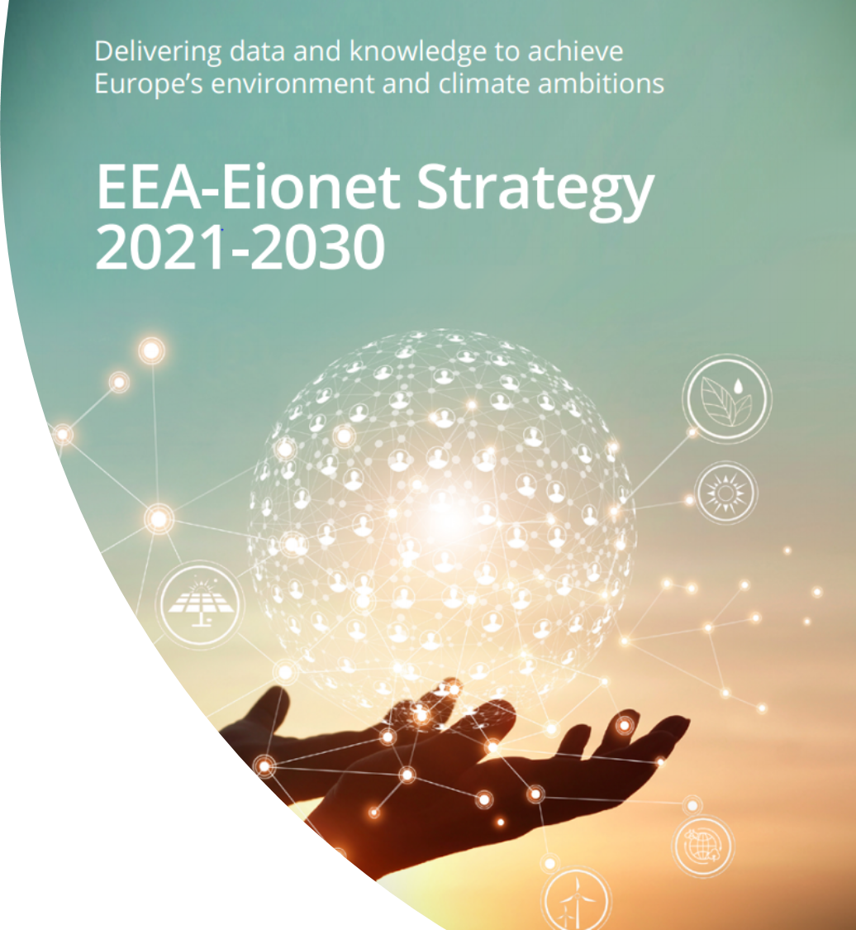
New ETCs with a partnership through to 2026
(with consortium coordinator)
A consortium of organisations from EEA member countries
Expertise in a specific environmental area
Contracted by the EEA to support the EEA/Eionet work programme
Capacity building for countries
Support data provision
Work on assessments and reports with EEA
Biodiversity and ecosystems
(NIVA)
Human health and the environment
(NILU)
Climate change adaptation and LULUCF
(CMCC)
Resource use and circular economy
(VITO)
Climate change mitigation
(VITO)
Sustainability transitions
(SYKE)
Data integration and digitalization
(EAA)
Institutional presence & visibility in Eionet
https://www.eionet.europa.eu/etcs

Slide 12
NEW WAYS OF WORKING
Co-creation As A New Way of Working With Eionet

Slide 13
What is Co-creation?
Collective Wisdom and Capacity nested in the Eionet
Ideas
Needs
Resources & expertise
Collaborative Innovation
Innovation
Co-created Value
New products
New concepts
New ideas
New questions
Priorities
Collaboration
Solutions and innovations lay not in one institution or one viewpoint, but in the bigger picture of collective intelligence.
Big or small contributions
Different levels of engagement
Takes time, dedication, and space for trial and error

Slide 14
The Principles of Co-creation:
Commitment
EEA & Management Board ensure required resourcing and backing for the co-creation projects and provide strategic direction, policy guidance and support.
Shared Ownership
EEA and Countries play shared and equal role and responsibility in designing, implementing, and promoting the co-creation projects.
Co-leadership
EEA and Countries co-lead the Eionet Groups and co-chair the cocreation projects.
Inclusiveness
EEA and Countries include all relevant experts into the process of co-creation to ensure an inclusive process with diversified participation.
Safe space for working together
EEA and Countries ensure a safe space for working together which requires openness, transparency, tolerance, flexibility, patience, trust, room for failure and experimentation.

Slide 15
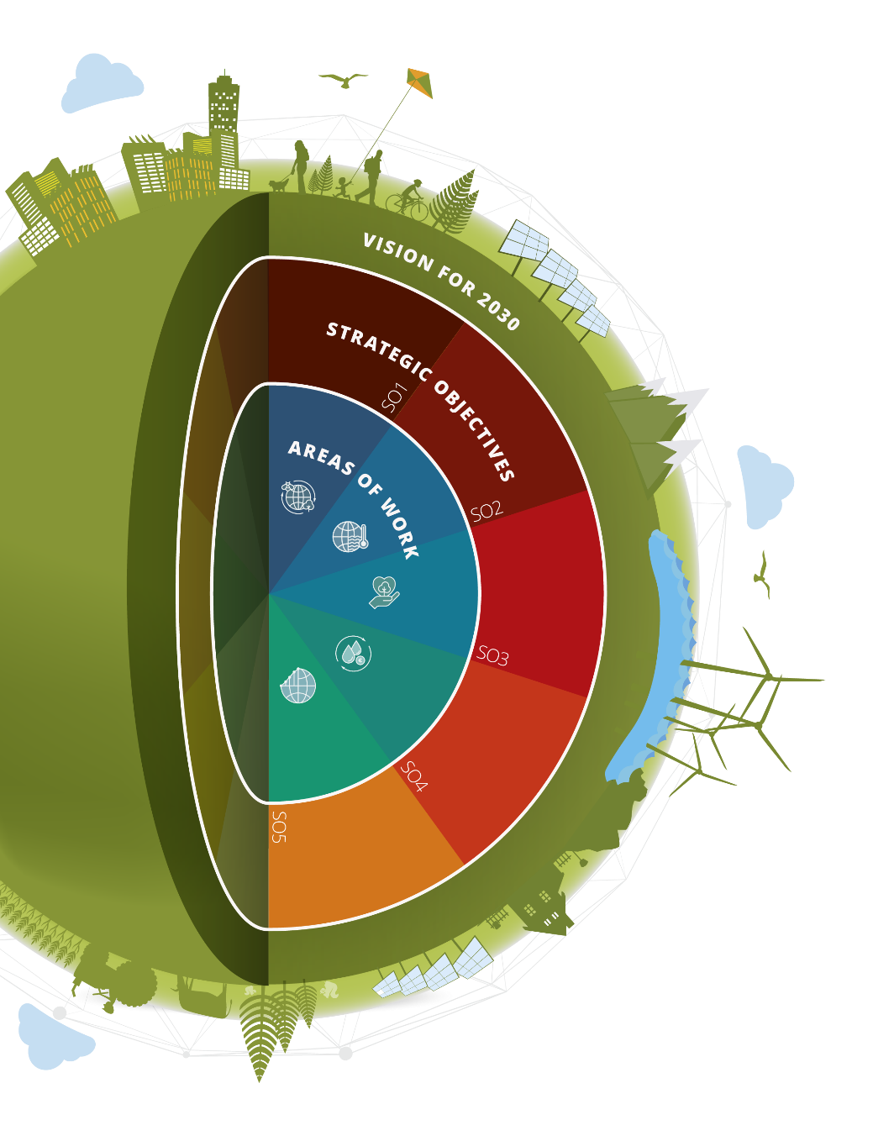
Roles and Responsibilities
EEA
Providing policy guidance, strategic direction
Facilitation of co-creation process
Ensuring link with SPD and 8th EAP
Countries
Identification of national priorities and stakeholders
Mobilization of experts
Ensuring link with national priorities and projects
Shared
Initiation of co-creation
Prioritization of co-creation projects,
Co-leading co-creation projects
Identification of best practices, sharing good examples and lessons learnt
ETC Involvement:
In case a co-creation project involves an ETC, involvement of that ETC in that specific co-creation project should be embedded in the ETC annual workplan.

Slide 16
The Process of Co-creation
Identify the Needs and Prioritise
Design the Process
Implement the project
Promote the output
Monitor and Evaluate results

Slide 17
Resources considerations
The new concept of
“Projects of Eionet Priority (PEPs)”
- Have the potential to bring high added value for the entire Eionet
- Have a cross-cutting nature
- Strongly help to achieve strategic objectives set in EEA/Eionet strategy
- Involve all Eionet countries
- Are considered under SPD

Slide 18
Eionet Communication Calendar
NEW WAYS OF COMMUNICATION

Slide 19
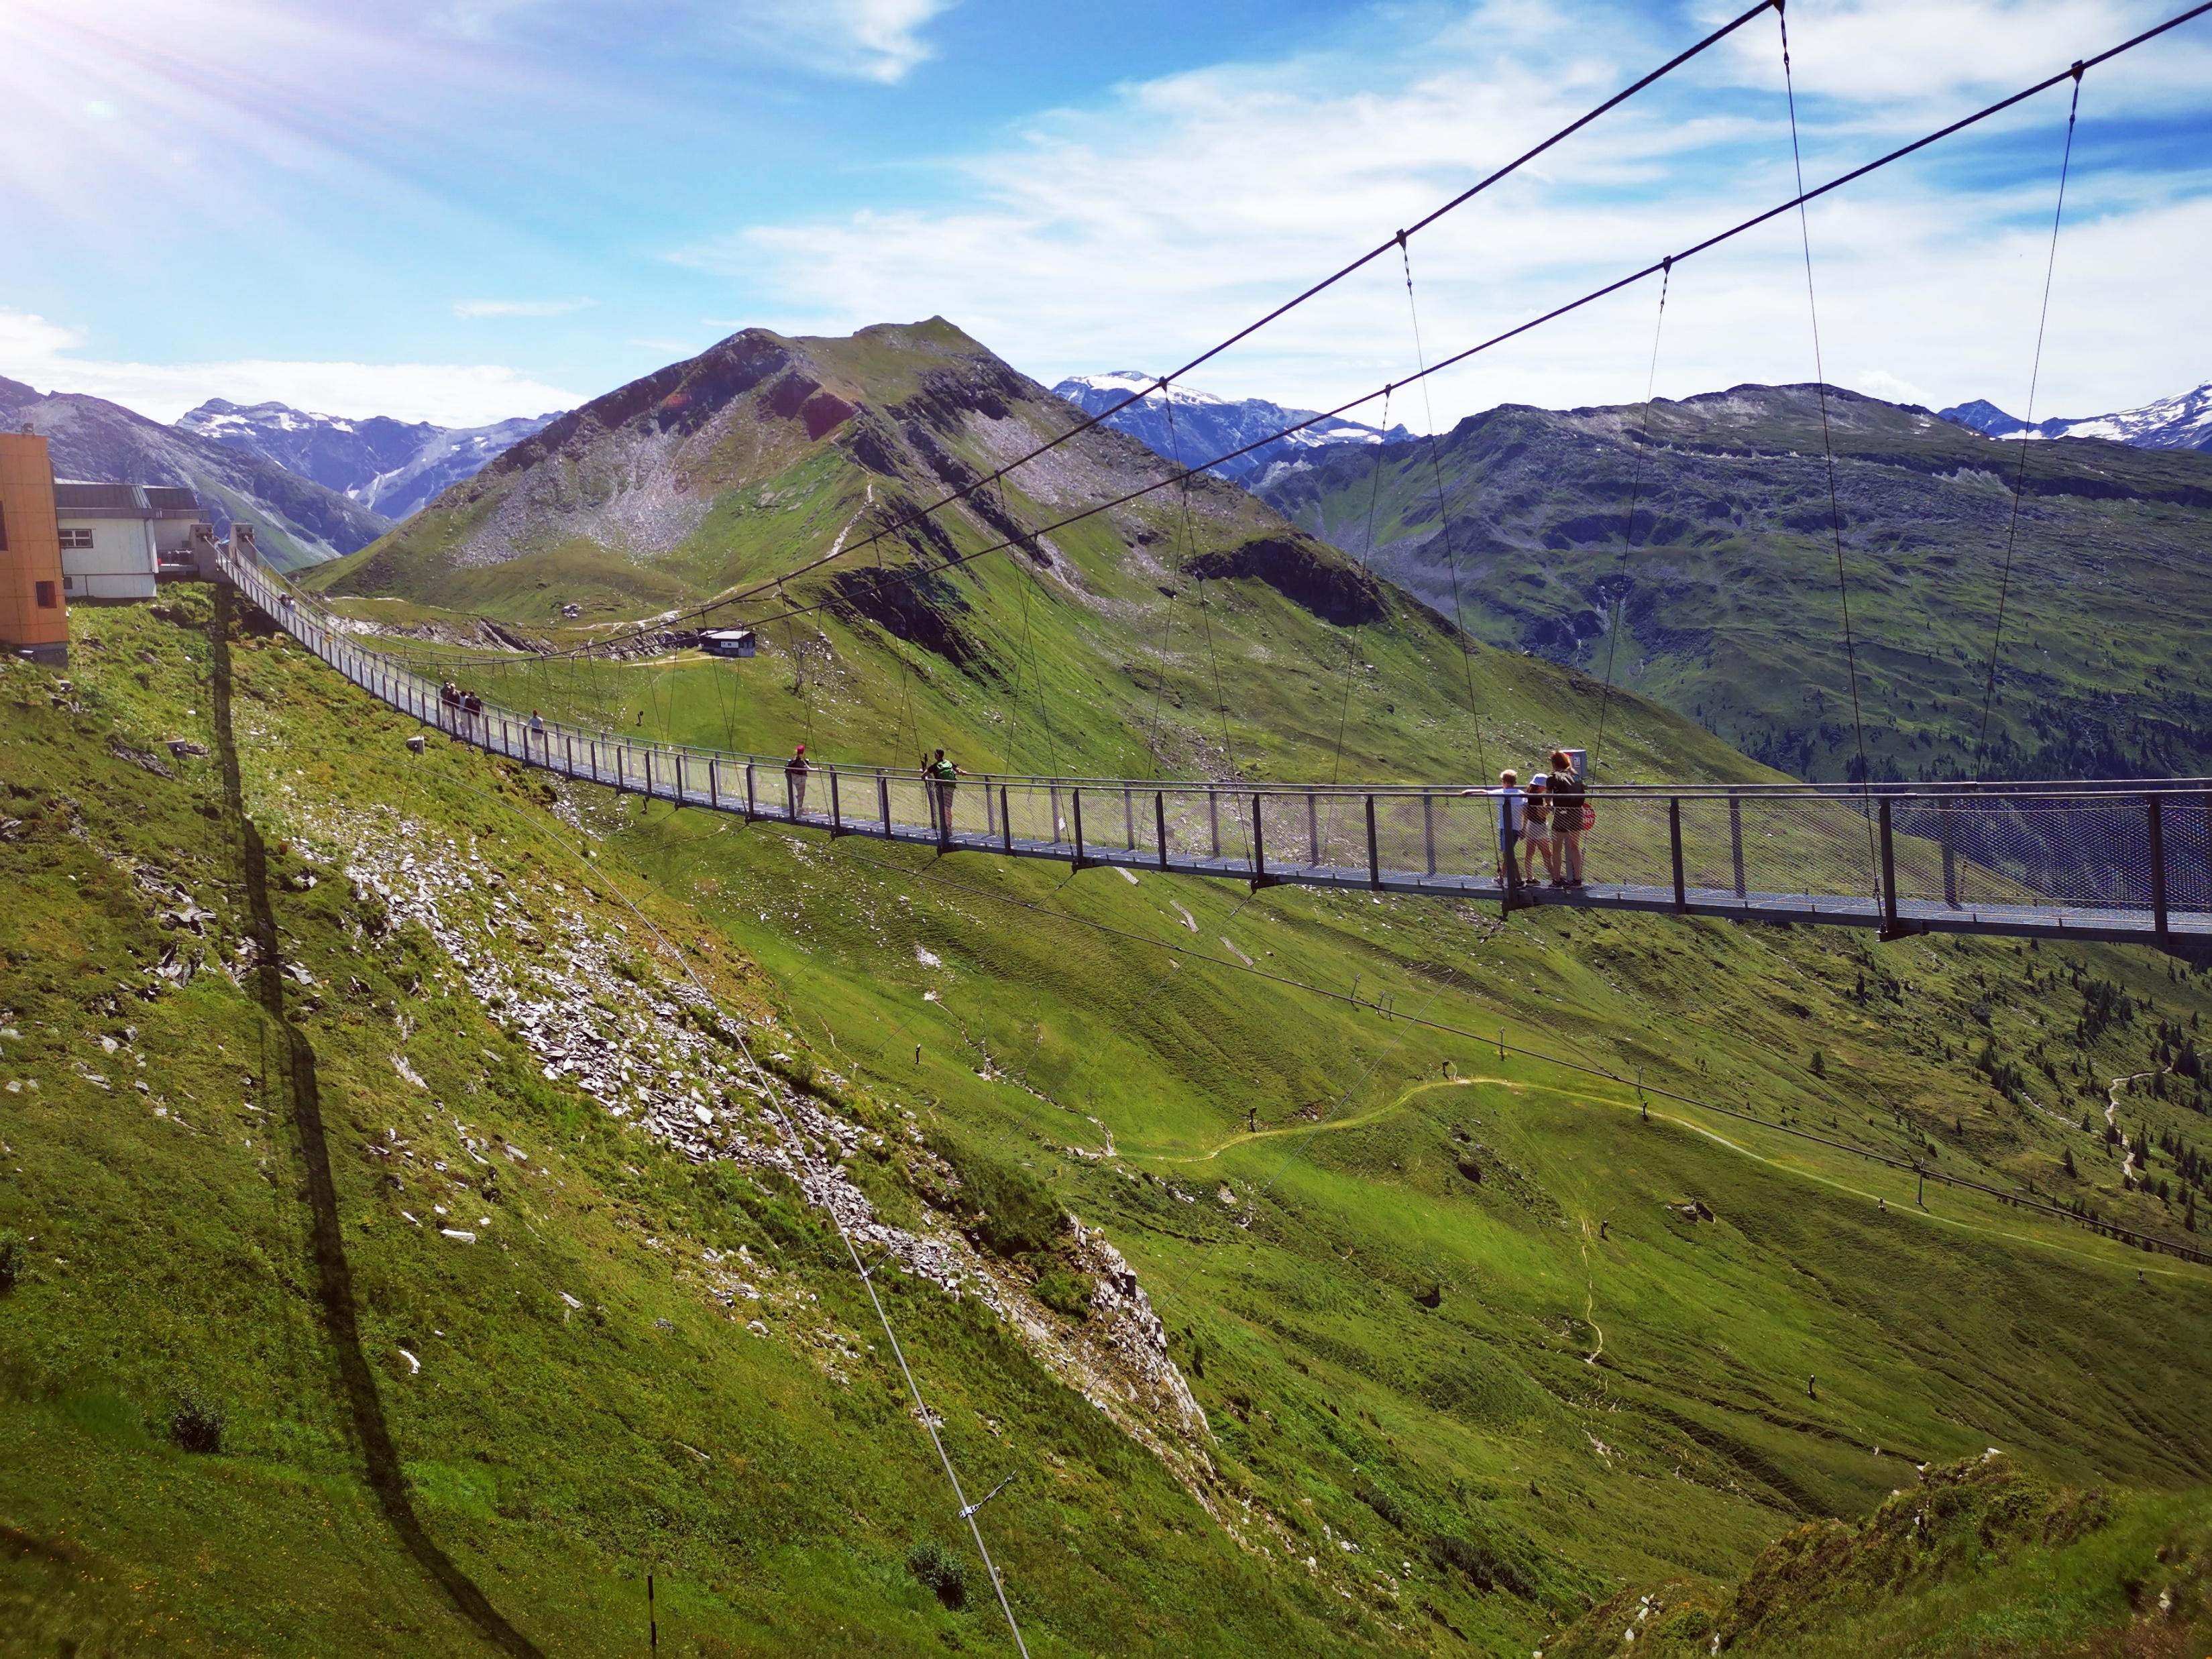
EEA-Eionet Communication Calendar
Purpose
Closer collaboration
Integrate communication throughout the knowledge co-creation process
Expand cooperation with EEA member countries
Build communication capacity throughout EEA-Eionet
Explore synergies by linking communication efforts
© Nicole Zallinger , Well with Nature /EEA

Slide 20
EEA-Eionet Communication Calendar
Calendar is under EXT-Eionet, Communication channel.
Calendar is composed of the important communication activities, events, publication etc.
EEA and all member countries are able to add activities to the calendar
Possible bilateral or multilateral interactions (such as; participation of the events from other members)
Only accessible by NFPs and Eionet Communication Group Members
NFPs and Communication group members are also welcome to inform relevant thematic expert to create a cooperation
© Katja Noack, Well with Nature /EEA

Slide 21
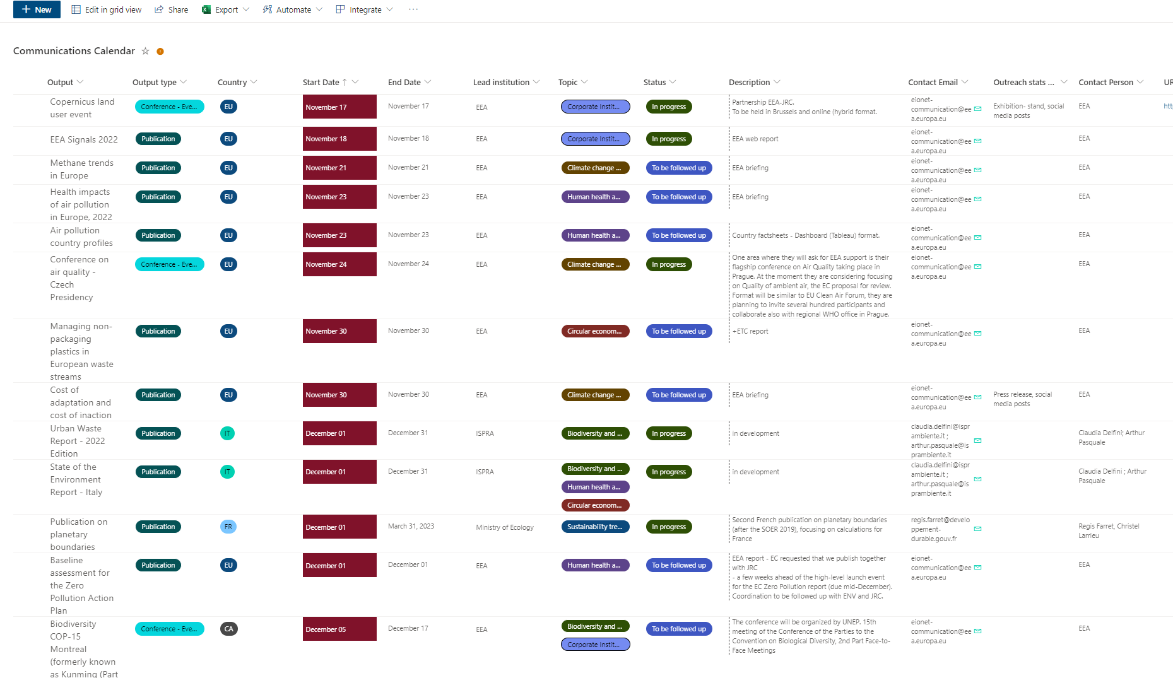
EEA-Eionet Communication Calendar

