Slide 1

Mustafa AYDIN
Expert - Regional Cooperation and Marine Knowledge
Mustafa.Aydin@eea.europa.eu
12 March 2019, Ankara
Black Sea Cooperation

Slide 2
Regional Seas Cooperation

Slide 3

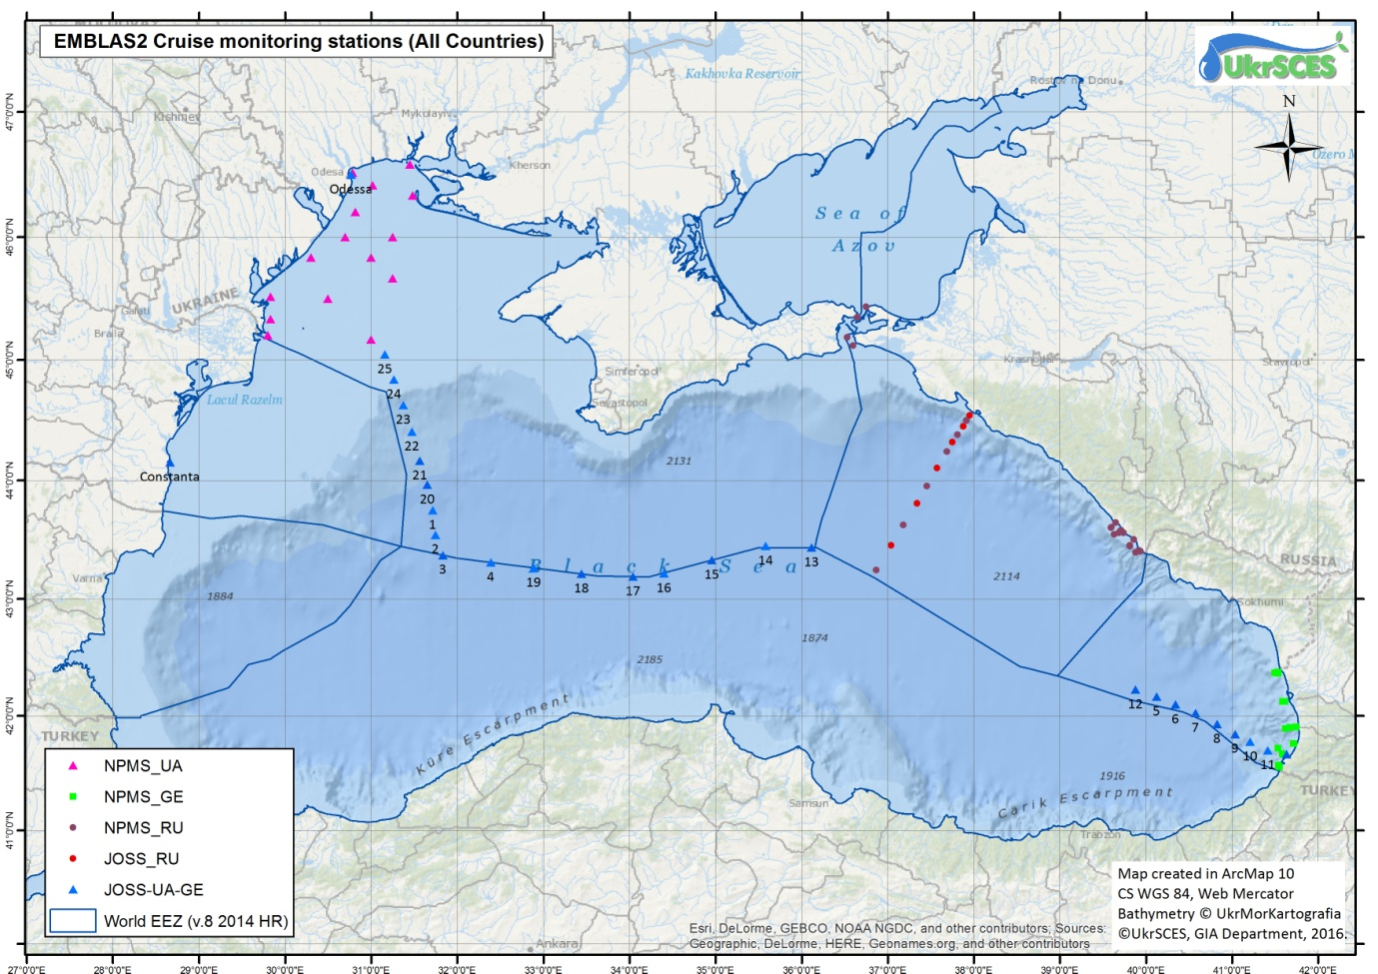
Black Sea data flows
The EU is not a party to Bucharest Convention.
The European Environment Agency (EEA) has a MoU with Black Sea Commission which allows data flows from the region.
In order to serve the purpose of EEA Marine Roadmap and marine assessments in particular;
A scoping document was prepared in 2017 to identify knowledge gaps and explore approaches to address them and it presented the mapping of the activities for a better presentation of the Black Sea region marine information.
EEA was represented in BSC COP meetings and close communication established with the BSC PS.
Close cooperation was established with the EU EMBLAS project and marine data flows recieved for 2016 and 2017 (EEA Eutrophication in Europe’s Seas Report, EEA Contaminants Europe’s Seas Report).
Communication with the DG NEAR established for further Black Sea projects to fill in marine data gaps.
EMBLAS II sampling stations in the Joint Black Sea Survey 2016 including NPMS UA, NPMS GE, JOSS UA-GE and JOSS RF

Slide 4
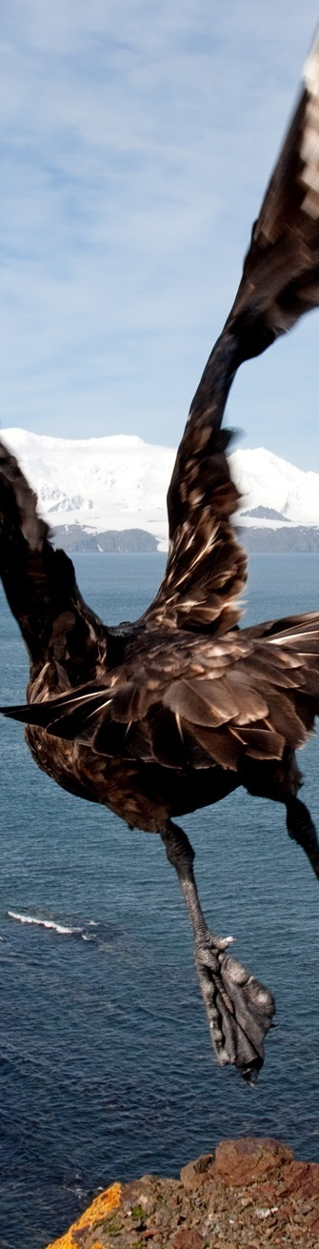
2017 and 2018 cooperation
In addition to regular reportings of EU member countries, EMODNet and ICES data;
EMBLAS II Project
Turkish nutrients data
Were utilized for;
EEA Marine Eutrophication report and EEA Marine contaminants report (to be published in 2019)

Slide 5
Future plans
RCSs and their operating mechanisms, have an important role to play in ensuring regionally coherent and consistent marine assessments. BSC PS capacity to access and assess the marine data is not strong.
EEA will continue to challenge the current conditions at the region and continue to work on gathering reliable data from all possible sources:
Ensuring data flow from possible resources as Copernicus Programme, EMODnet, ICES, EU funded marine projects as EMBLAS+ and ANEMONE and BS countries for the EEA products (2018-2019)

Slide 6
Improve availability and sharing of marine environmental data from the national and joint regional monitoring programmes aligned with the MSFD and WFD principles and the Black Sea Integrated Monitoring and Assessment Programme (BSIMAP)
Marine litter: ensure the micro and macro ML monitoring, Marine Litter Watch: Data reporting and dissemination of the MLW app usage
EEA and EMBLAS, ANEMONE coordinated data work to combine other EEA member data and reporting efoorts in order to create holistic assessments
Governance in the Black Sea region: Support to Black Sea Commission; close cooperation and operational support for its activities in order to ensure sustainability of future BS reporting
Tracking and inclusion of all quality controlled data generated within EMBLAS, MISIS and selected historical data
Possible cooperation with the ENI SEIS East activities

Slide 7
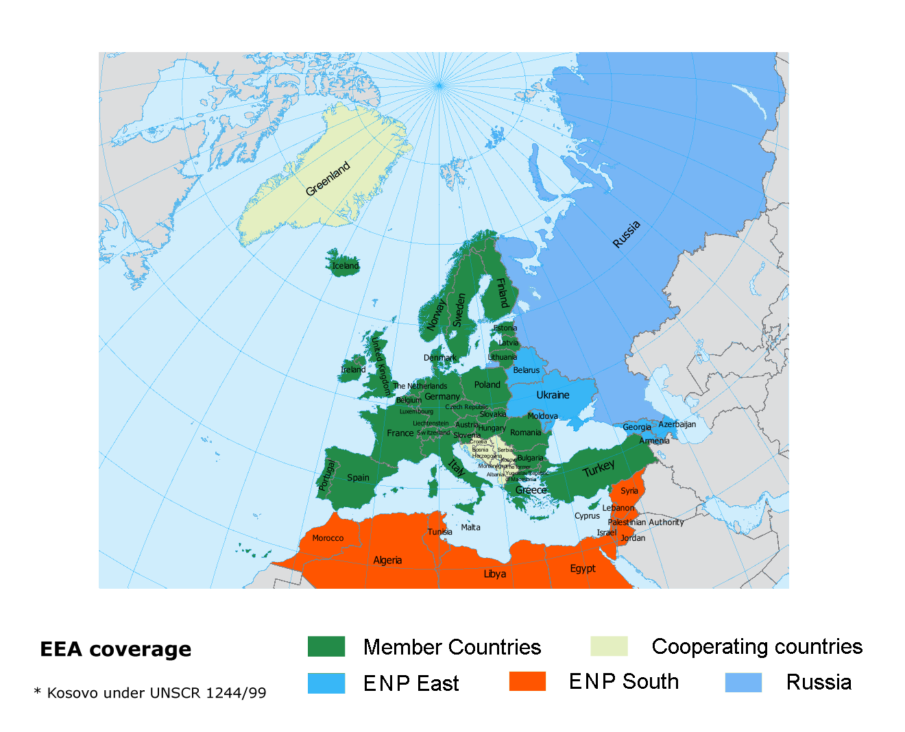
Cooperation with Regional Seas Conventions ENI East

