Slide 1
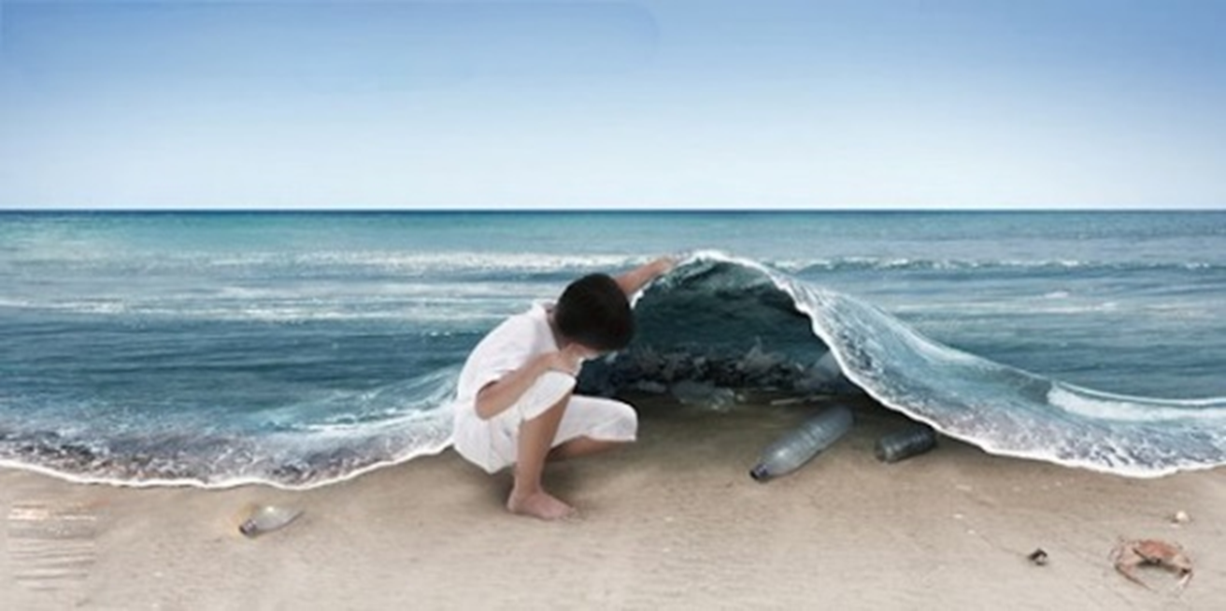
Marine Litter Monitoring in Europe
Presentation by EEA – Mustafa Aydın
Mustafa.Aydin@eea.europa .eu
Notes:
God morning

Slide 2
Monitoring marine litter
MSFD requires regular monitoring and reporting of the member states
MSFD GES Descriptor 10 defines 3 descriptors for good environmental status target
MSFD TGML is developing guidelines for monitoring and common thresholds for the indicators
MSFD reporting for GES descriptors 2020
EEA is developing indicator scoping in 2019

Slide 3
Key Policy Questions for Marine Litter
D10 ‘Properties and quantities of marine litter do not cause harm to the coastal and marine environment’
Are the composition, amount and spatial distribution of litter and micro-litter on the coastline, in the surface layer of the water column, and on the seabed or in seabed sediment, at levels that do not cause harm to the coastal and marine environment? (D10C1) (D10C2)
Is the amount of litter and micro-litter ingested by marine animals at a level that does not adversely affect the health of the species concerned? (D10C3)
What is the number of individuals of each species, which are adversely affected due to litter, such as by entanglement, other types of injury or mortality, or health effects? (D10C4)

Slide 4
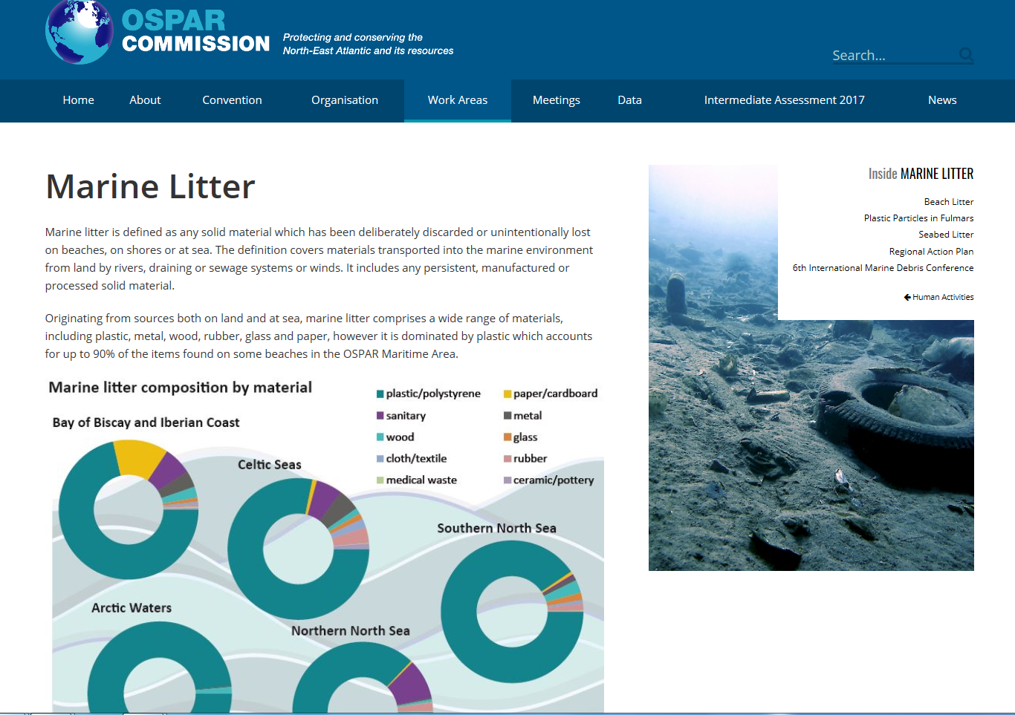

MONITORING EFFORTS
RCSs are monitoring litter and they already developed indicators
OSPAR; sea bed litter, beach litter, plastics in fulmars
HELCOM; Marine litter regionla action plan, sources and pathways, reduction
MAP; beach, floating, reduction targets for the indicators, guidelines
http://www.helcom.fi/action-areas/marine-litter-and-noise/marine-litter/marine-litter-action-plan/
https://www.ospar.org/work-areas/eiha/marine-litter

Slide 5
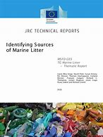
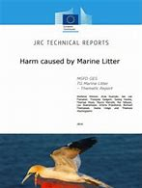
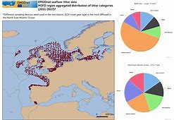
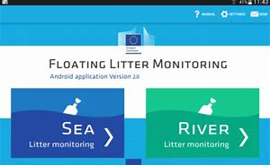
Joint Research Center
Guidelines for monitoring and eforts on harmonisation of the monitoring methodology
JRC floating litter app
RIMMEL project, riverine litter module
EMODnet
EMODnet chemistry prepared litter maps
EU Projects and scientific studies
https://ec.europa.eu/jrc/en/
http://www.emodnet-chemistry.eu/welcome

Slide 6
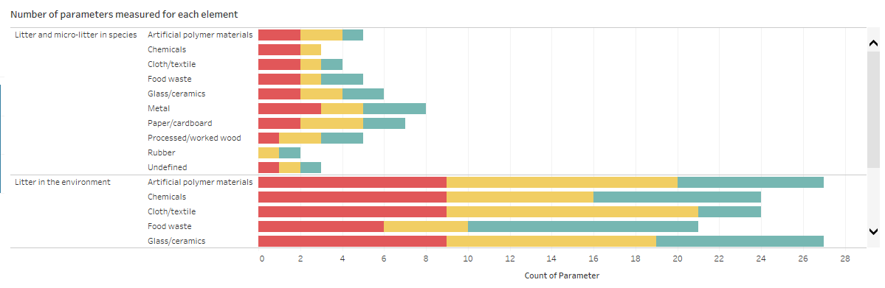
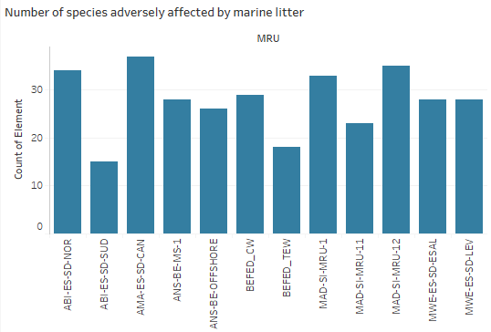
EEA MSFD Dashboards
Across Europe’s seas X% of the reported assessment area was reported in ‘good’ status and X% in ‘bad’ status. X% was either ‘not reported’ or ‘not assessed’ (Figure 10.1). X countries had reported by xxx.
Detailed dashboard information available here
Figure 10.2 Amount of litter and micro-litter ingested by marine animals

Slide 7
EEA Marine Litter Indicators
EEA will complete a ML indicators scoping task in 2019
  ML Beach indicator will be finalised (based on TGML list, top 10 items, available information on environmental effects, links to the source: Draft SUPs Directive and EEAs role in the directive)
  Macro litter indicators will be selected for further development (screening of the existing indicators and policy requirements and proposal for ML indicators – a scoping document in 2019)
  Pathways and sources of litter
  Proposed indicators will be in line with the MSFD Descriptor 10
  A workshop will be organised in June (with the participation of JRC, EMODNet, EC, RCSs) in order to discuss draft scoping document and indicators

Slide 8
Key messages on monitoring results
Plastic items are the most abundant and damaging component of marine litter.
Single use plastics (SUPs) are a big threat to marine environment. The 10 most found SUP items represent 50% of all litter items found on European beaches by count. Fishing gear containing plastics accounts for another 27% of marine litter items found on European beaches.
Rivers play an important role in transporting all sorts of litter items from the terrestrial to the marine environment.
Litter is abundant on beaches in the European Seas. Plastic fragments, fishing-related litter and packaging are the most common types of litter found. Plastics comprise over 80% of items.

Slide 9
Litter is widespread on the seafloor across the areas assessed, with plastic the predominant material encountered.
Although there is no regular regional monitoring, all scientific studies being made indicate the existence of considerable amounts of micro litter in the rivers and seawater.
Ingestion of plastic is widespread by fish and bird species in the European seas. Levels of plastic ingestion by fulmars in the North Sea appear to have stabilised at around 60% of individuals exceeding the 0.1 g level of plastic ingestion.
Impacts of marine litter are harming marine ecosystems, through litter ingestion, entanglement, enhancing the spread of non-native species, and potential toxicity of released chemicals from plastic. Population level effects are still unknown.

