Slide 1
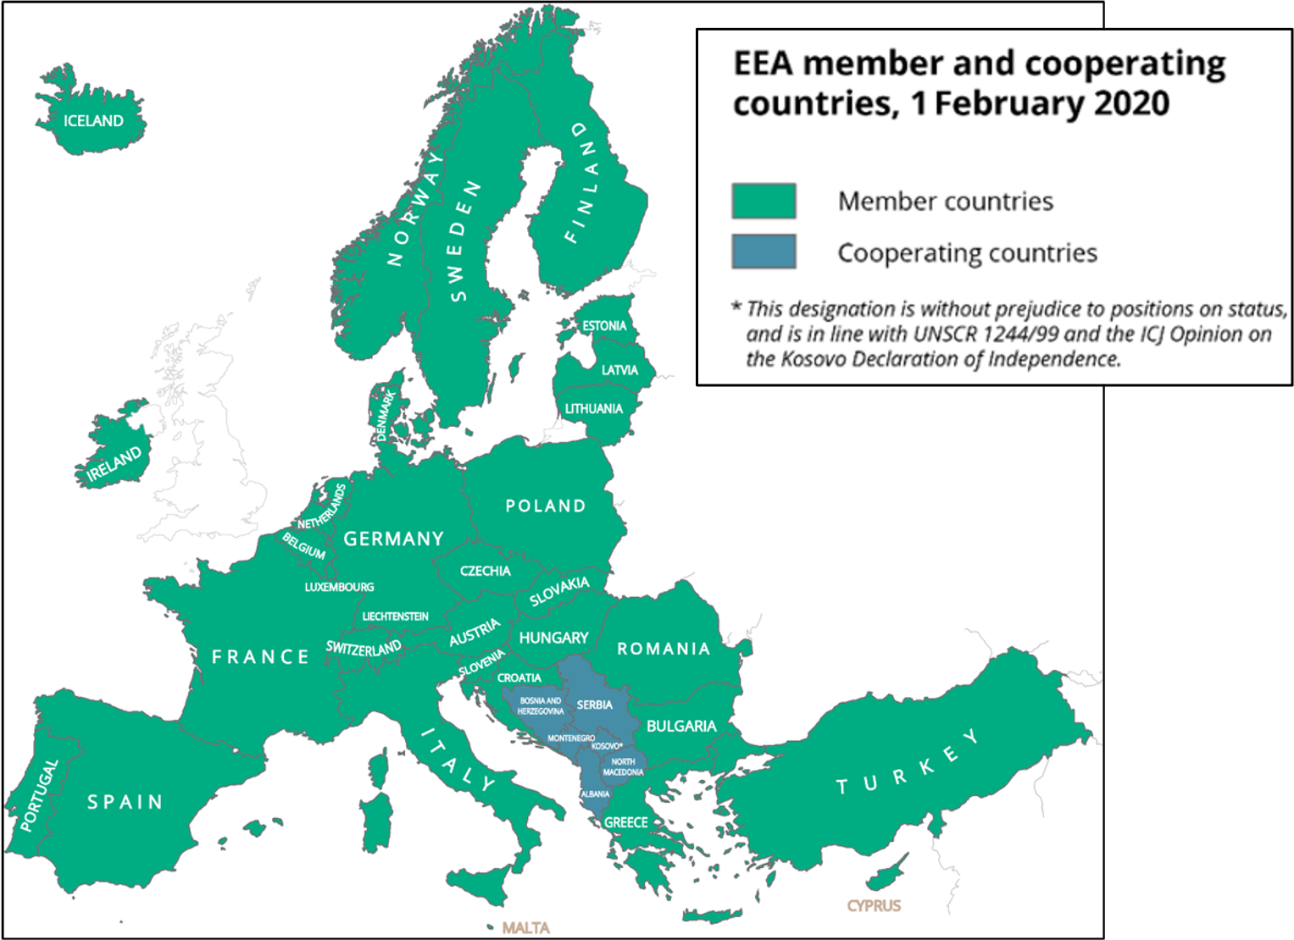
Informing
policy implementation
Assessing systemic challenges
Supporting countries:
Knowledge
co-creation, sharing and use
What we do

Slide 2
Management board
EEA countries
European Commission
European Parliament
Eionet
EEA
Scientific committee
Governance
EPA network

Slide 3
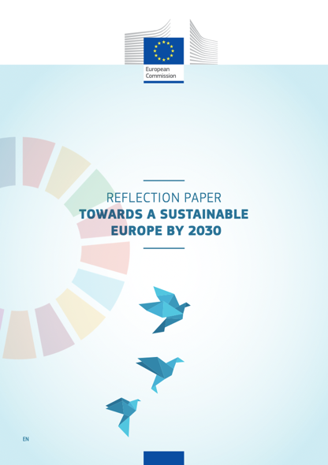
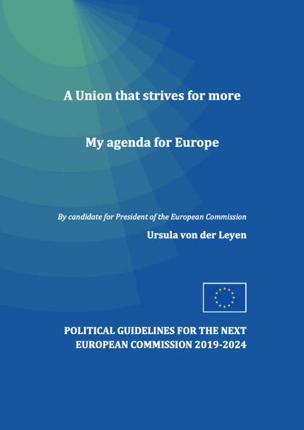


EEA-Eionet: Helping shape the emerging policy discourse

Slide 4





…and supporting EU contributions to international processes
Notes:
Support the EU contribution to UNEA-5.2, Stockholm+50, COP 15 and 27 and other key international processes with dedicated side-events
Implement the EEA-UNEP/MAP strategic partnership responding to the EU Strategy for Mediterranean
Maintain key partnerships with UN bodies (UNECE, UNDP, UNSD)
Continue promoting EEA-Eionet dimension in regional settings, e.g. Euro-Med & Regional Sea Forum
Expected Eionet involvement:
Enhanced & coordinated EEA-Eionet interaction with key international partners & global processes
Close exchange with Eionet partners on activities internationally and ensure value-added of the network in international setting
Support to the implementation of the EEA Framework for International Engagement (to be finalized Q2 2022)

Slide 5
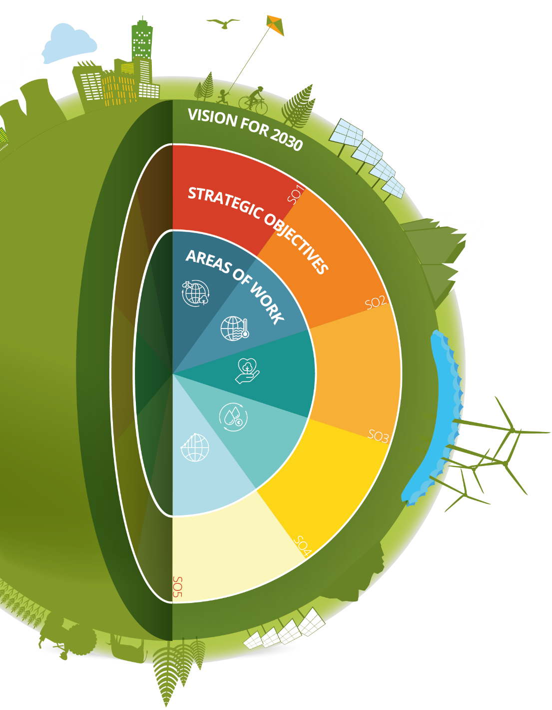
EEA-Eionet Strategy 2021-2030: Strategic objectives
SO1
SO2
SO3
Supporting policy implementation and sustainability transitions
Providing timely input to solutions for sustainability challenges
Building stronger networks and partnerships
SO4
SO5
Making full use of the potential of data, technology and digitalisation
Resourcing our shared ambitions
Notes:
The EEA Strategy does not address cities or the urban dimension per se or explicitly
Tomorrow and after tomorrow – the Urban Stakeholders will reflect on how to “localise” all these strategic objectives (See notes for slide 1)

Slide 6


EEA work areas supporting…
First climate-neutral continent, incl. Adaptation Strategy
Biodiversity Strategy 2030
New Circular Economy Action Plan
Zero pollution strategy
Farm to fork strategy
Just transition
Sustainable European Investment Plan
Future ready economy – new industrial strategy

Slide 7

EEA-Eionet Strategy 2021-2030: Implementation
Through strategic investments in:
Networking and partnerships (Eionet modernisation)
Digitalisation (IT framework)
Creating a learning organisation (incl. recruitment)
Trusted, supportive and agile communication
Research-science-policy interface
Monitoring progress to sustainability (incl. indicators, SOER 2025 trajectory)
Notes:
Focus on
Continuity
Innovation
Flexibility
Resilience
In our knowledge, networking, technology, tools and narrative
Integrated policy frameworks necessitate more integrated knowledge creation across the EEA and Eionet, not situated within one part of the organisation or the strategy
To create more systemic, actionable knowledge, we need connectors:
Connecting across EEA and Eionet
Connecting with research communities
Connecting with new policy audiences
This is about recruitment, capacity development and organisational learning
Capacity-building both ’inside-out’ and ‘outside-in’
EEAcademy
EEA-Eionet communities of practice / social learning network
Learning and development (framework)
The future workplace
HRM framework
The digital workplace
Office facilities
The EEA is investing in further strengthening its role as a bridge between research, science and policy, e.g.
Stronger institutional links with EU-ANSA, DG R&I, JRC, scientific communities
Better engagement with EU Framework Programmes on Research and Innovation, enabling the EEA to take up, use and disseminate research outputs in a systematic way
Special attention to new missions and partnerships under Horizon Europe

Slide 8
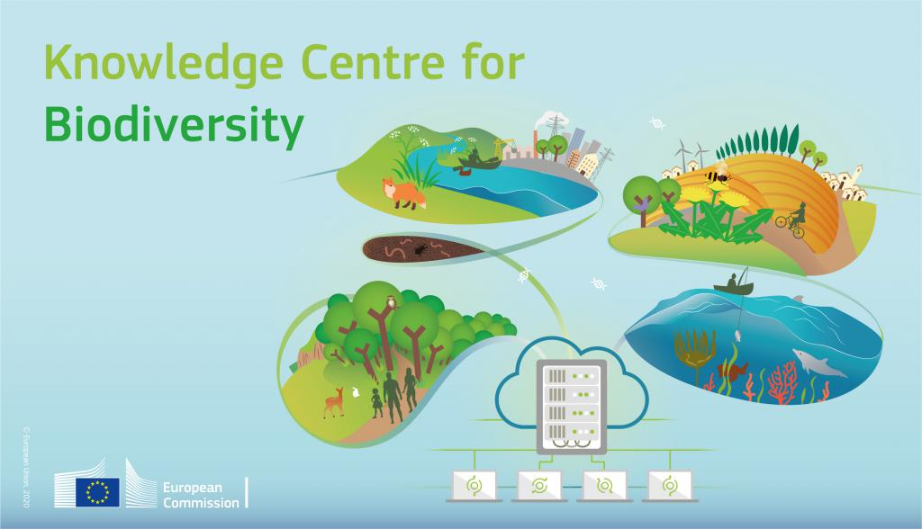



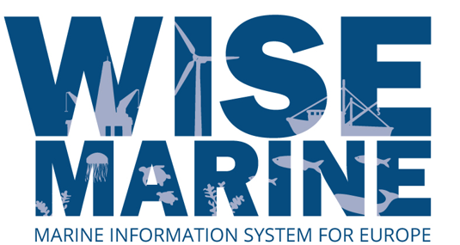


Information and knowledge at the heart of progress to 2030

Slide 9

A digital agenda for Europe, and for EEA-Eionet

Slide 10




A new frontier of data
Coordination of in situ EIONET data across services
Implementation of European and local land monitoring
Key user of Copernicus Data and Information Products
10

Slide 11
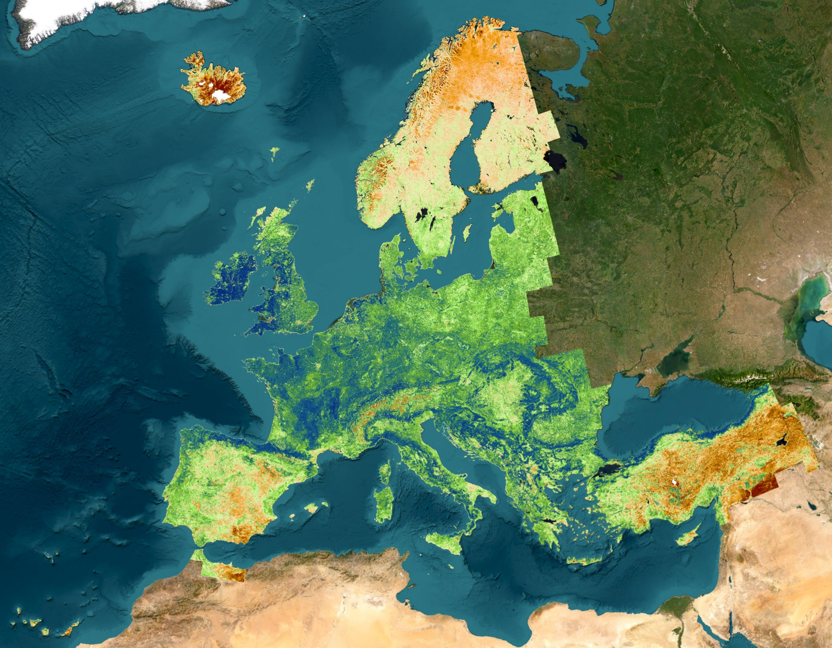

Slide 12
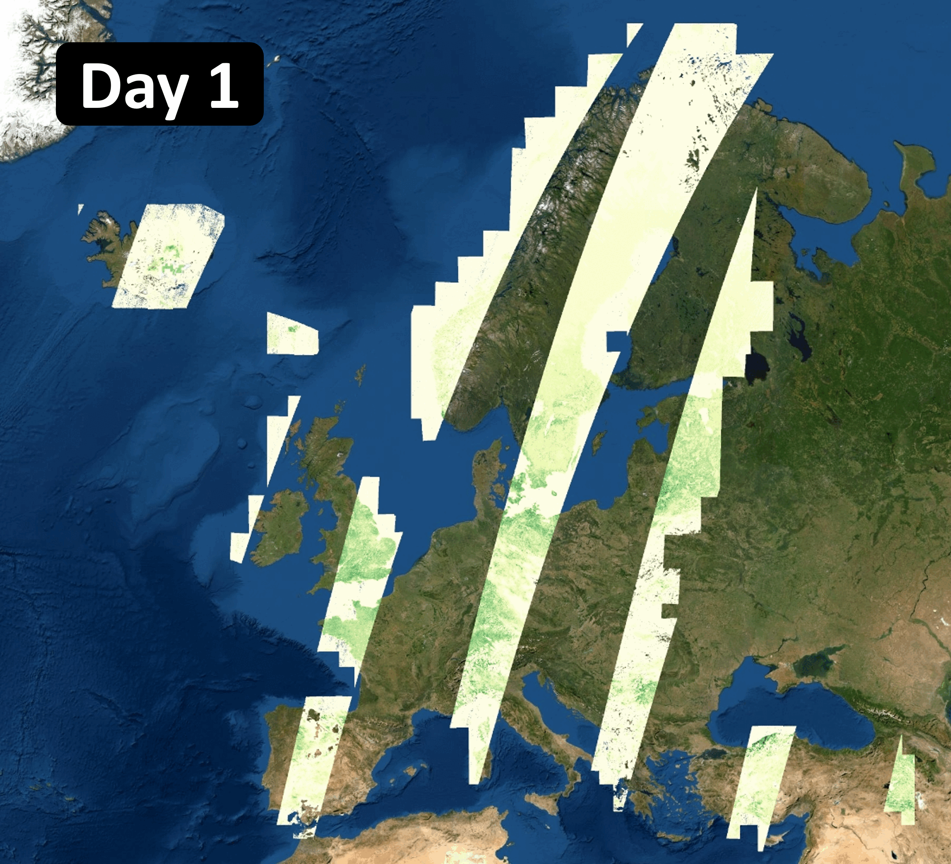

Slide 13
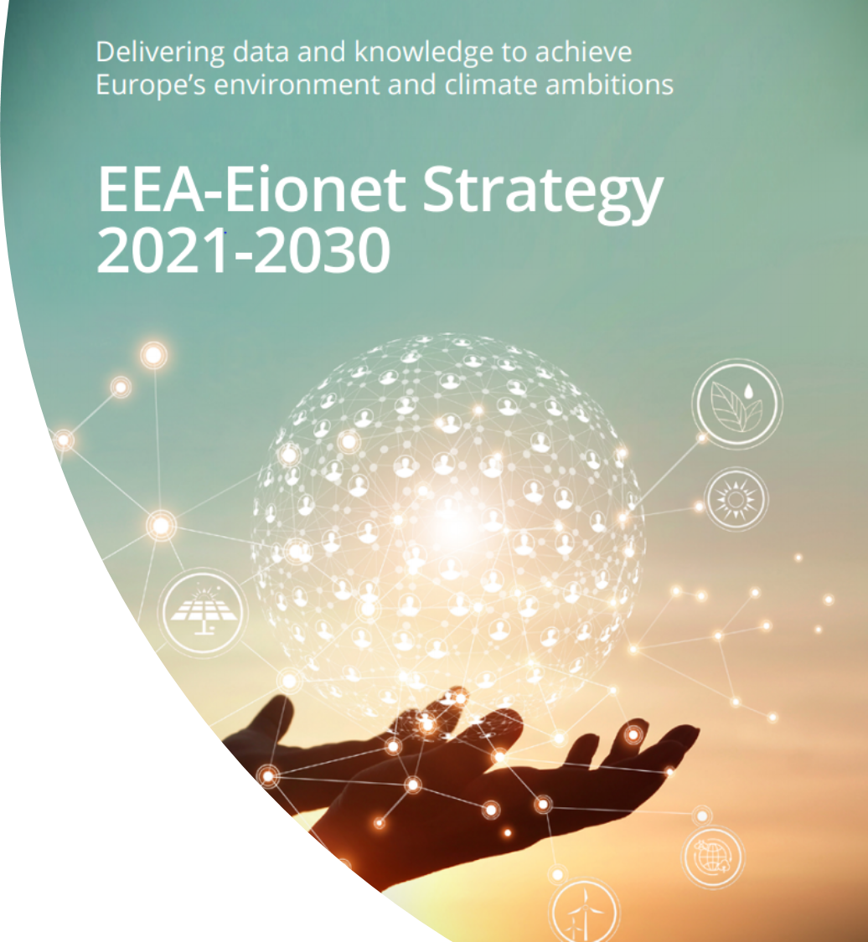
“a more flexible and innovative knowledge network”
“more active engagement at the country level”

Slide 14
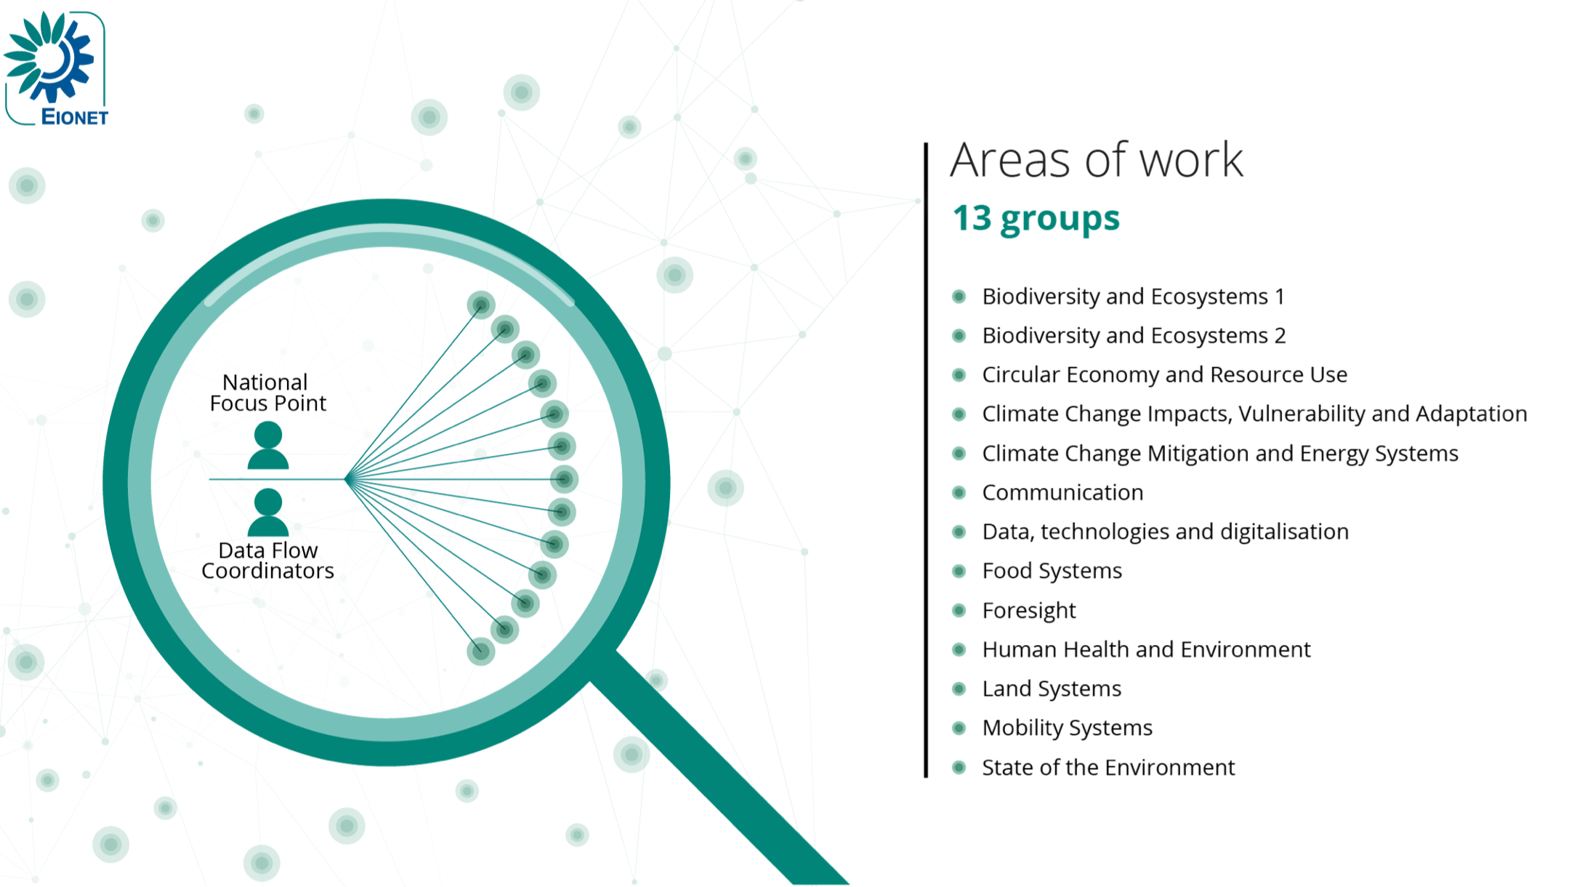
Network power: Working across thematic areas to support EU policy

Slide 15


New ETCs with a partnership through to 2026
(with consortium coordinator)
Biodiversity and ecosystems
(NIVA)
Human health and the environment
(NILU)
Climate change adaptation and LULUCF
(CMCC)
Resource use and circular economy
(VITO)
Climate change mitigation
(VITO)
Sustainability transitions
(SYKE)
Data integration and digitalization
(EAA)
Institutional presence & visibility in Eionet
https://www.eionet.europa.eu/etcs

Slide 16







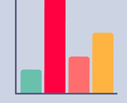
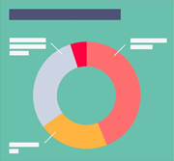




Reportnet 3: New Eionet eReporting platform
Improved user experience
User-friendly
Inline support
Collaborative
Better performance
Process
optimisation
Less time and resources spent
in preparation of reporting
Improved
data quality
Better data management
Optimized data
delivery
Enhanced quality control
System-to-system
delivery
Dashboards & visualizations
First dataflows reported on new platform in 2021
All new dataflows use the platform
Migration of legacy dataflows from Reportnet 2 over the following years
https://reportnet.europa.eu/

Slide 17
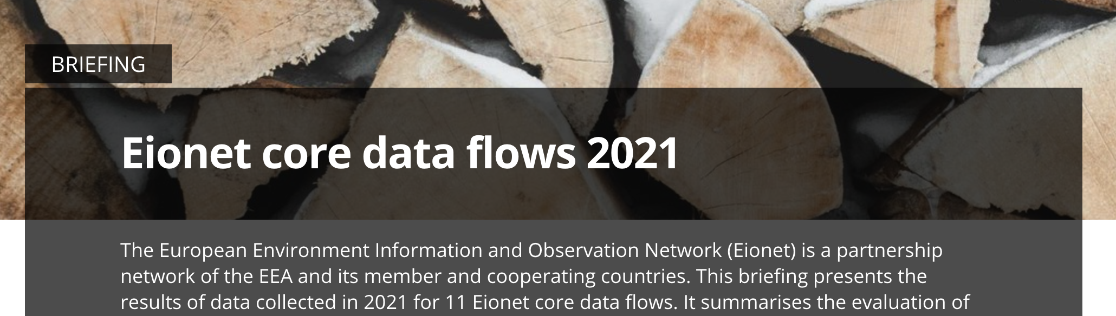
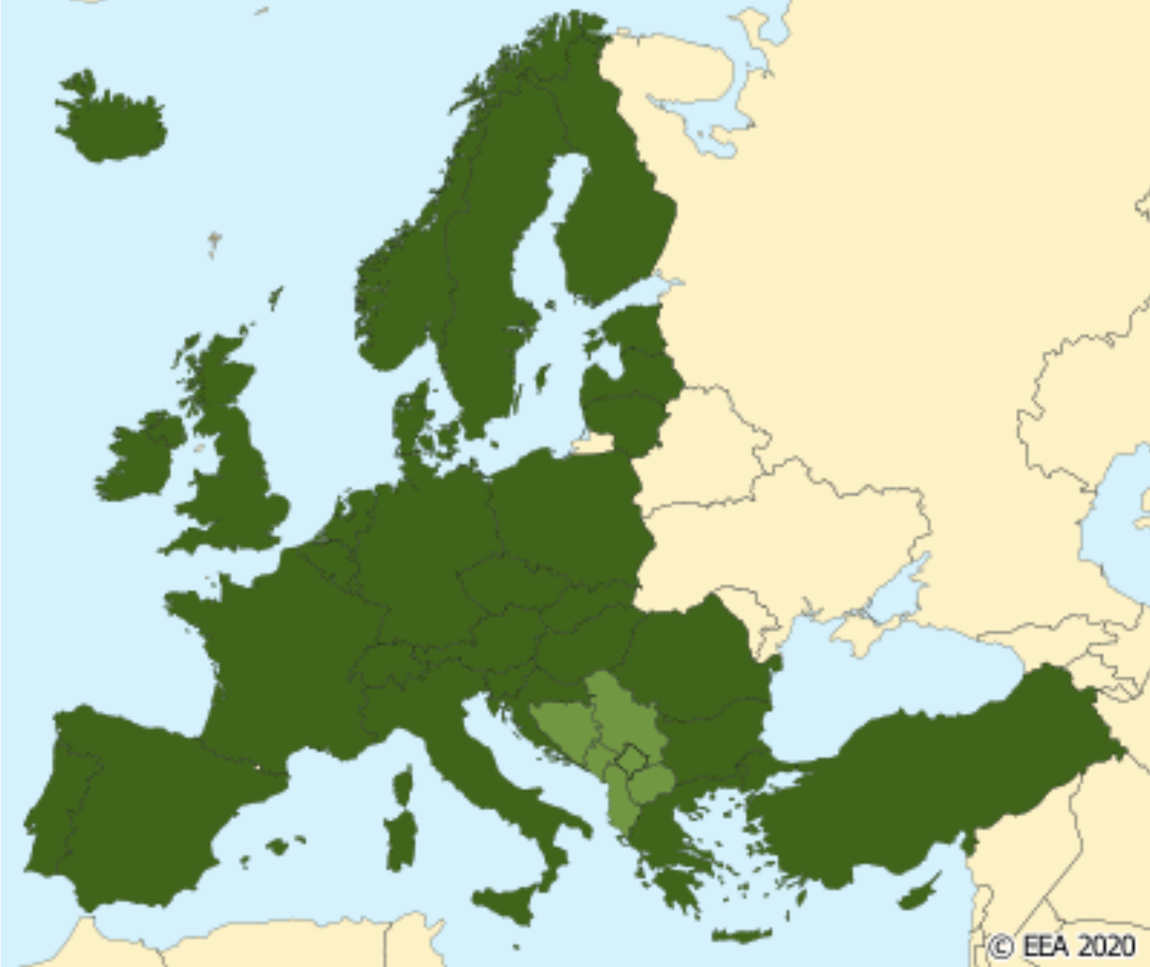
Eionet core data flows
Reported by EEA member and cooperating countries using Reportnet
Selected dataflows used in EEA assessments, products and services
Encouraging countries through friendly competition

Slide 18
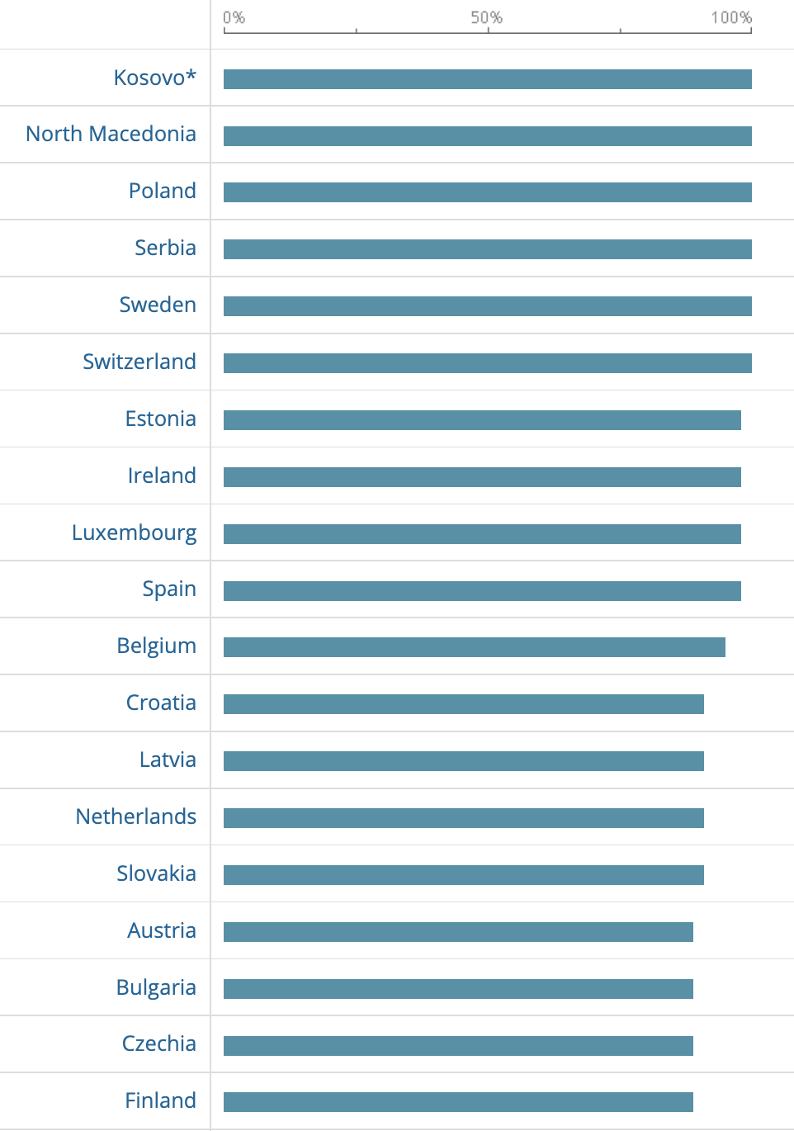
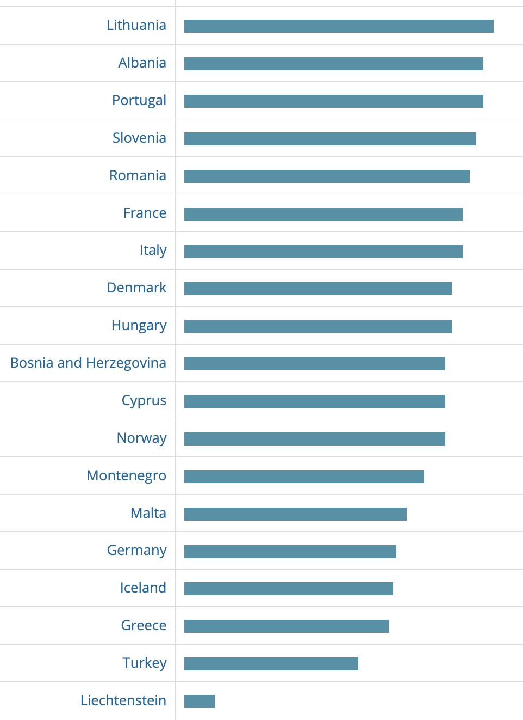
Eionet core data flows 2021: Turkey
50%

Slide 19

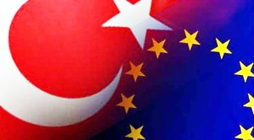


Enhanced Cooperation Agenda:
Türkiye and EEA, 2021-2023
Strengthening expert capacity in Turkish institutions
Supporting priorities of Turkish environmental policy
Close link with Eionet network and modernisation process
Implemented with support of the Turkish Ministry, other relevant institutions and EU Delegation to Türkiye
Close cooperation between different partners/organisations in national network
Notes:
Enhanced Cooperation Agenda between Türkiye and the EEA covering 2021-2023 period.
Overall objective: to strengthen the expert capacity in Turkish institutions to respond to the EEA-Eionet Strategy, while supporting the national priorities of the environmental policy of Türkiye.
Close link with the modernisation process and activities of the Eionet network.
Implemented with the support of the Ministry of Environment, Urbanisation and Climate Change, other relevant institutions and the EU Delegation to Türkiye.
Based on close inter-institutional cooperation between the different partners/organisations in the national network.

Slide 20

Thematic activities covered under the enhanced cooperation agenda
Regular dialogue on implementation with MoEU and stock-taking of parallel project activities supported by TAIEX and EU Delegation in Ankara
Examples of EEA support to Turkish colleagues on 2021-22 period:
Air quality
Climate change
Biodiversity
Water and Marine
Waste and waste management
Cross-cutting topics
Environmental assessments
Notes:
Regular dialogue on implementation with MoEU and stock-taking of parallel project activities supported by TAIEX and EU Delegation in Ankar
Examples of EEA support to Turkish colleagues on 2021-22 period:
Air quality: training on COPERT software, indicators development, EMEP calculations
Climate change: training on GHG emissions, national Climate ADAPT, CC adaptation
Biodiversity: training and helpdesk support to CDDA reporting
Water and Marine: training and helpdesk support to data reporting to WISE
Waste and waste management: support participation of Turkish experts to the respective Eionet workshops at the EEA
Cross-cutting topics: digital transformation, environmental-economic accounting
Environmental assessments and SoE reporting

Slide 21
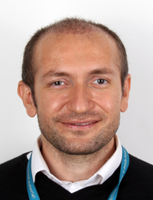
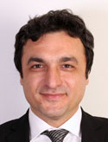
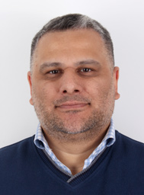
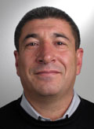
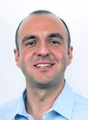
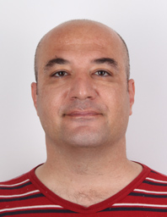
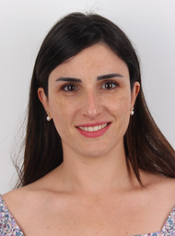
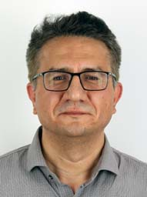
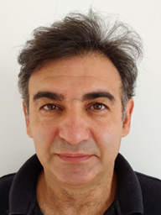
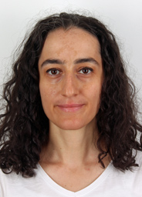
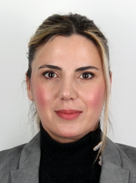
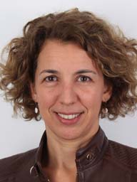
Türkiye’s contribution to the EEA expert pool
Ahmet Goktas – External Communications Expert
Dr. Mustafa Aydin – Zero Pollution Expert
Bekir Yilmaz – ICT Expert
Dr. Nihat Zal – Water Resources Expert
Deniz Aydemir – Digitalisation Expert
Ovunc Uysal – Environmental Indicators Expert
Eda Bayar Aydin – Cooperation with the Regional Sea Conventions - Expert
Tolga Sari – Marine and Maritime Data Information expert
Teoman Sanalan – Environmental Indicators Expert
Dr. Eylem Dogan Subasi – Pollution Free Ecosystems Expert
Gülcin Karadeniz – Head of Group, Media Relations​, social media and web
Tulay Gungor – Networks and Eionet Modernisation Expert

Slide 22
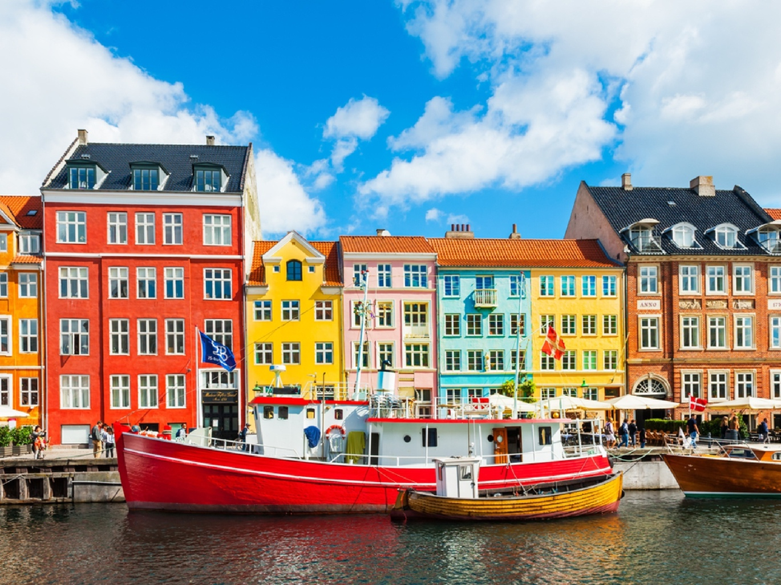
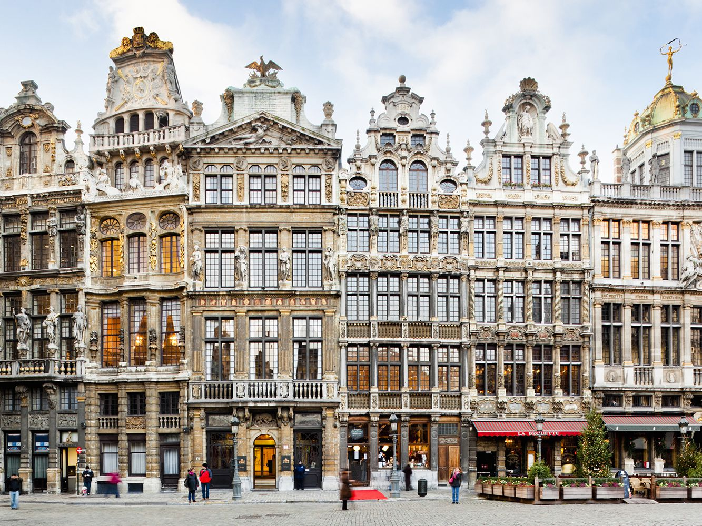
EEA-Eionet Day / Stakeholder Event, March 2023

Slide 23
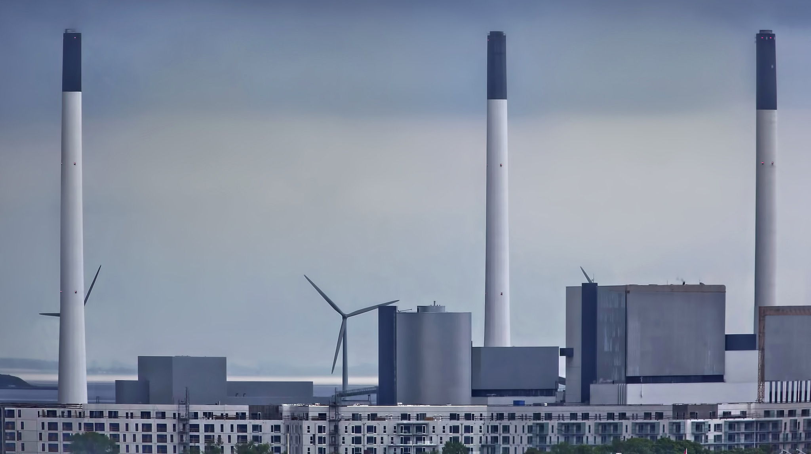
Thank you
Hans Bruyninckx | Türkiye Country Visit| 5 December 2022
© Andrzej Bochenski, Picture2050 /EEA

